Slide 1
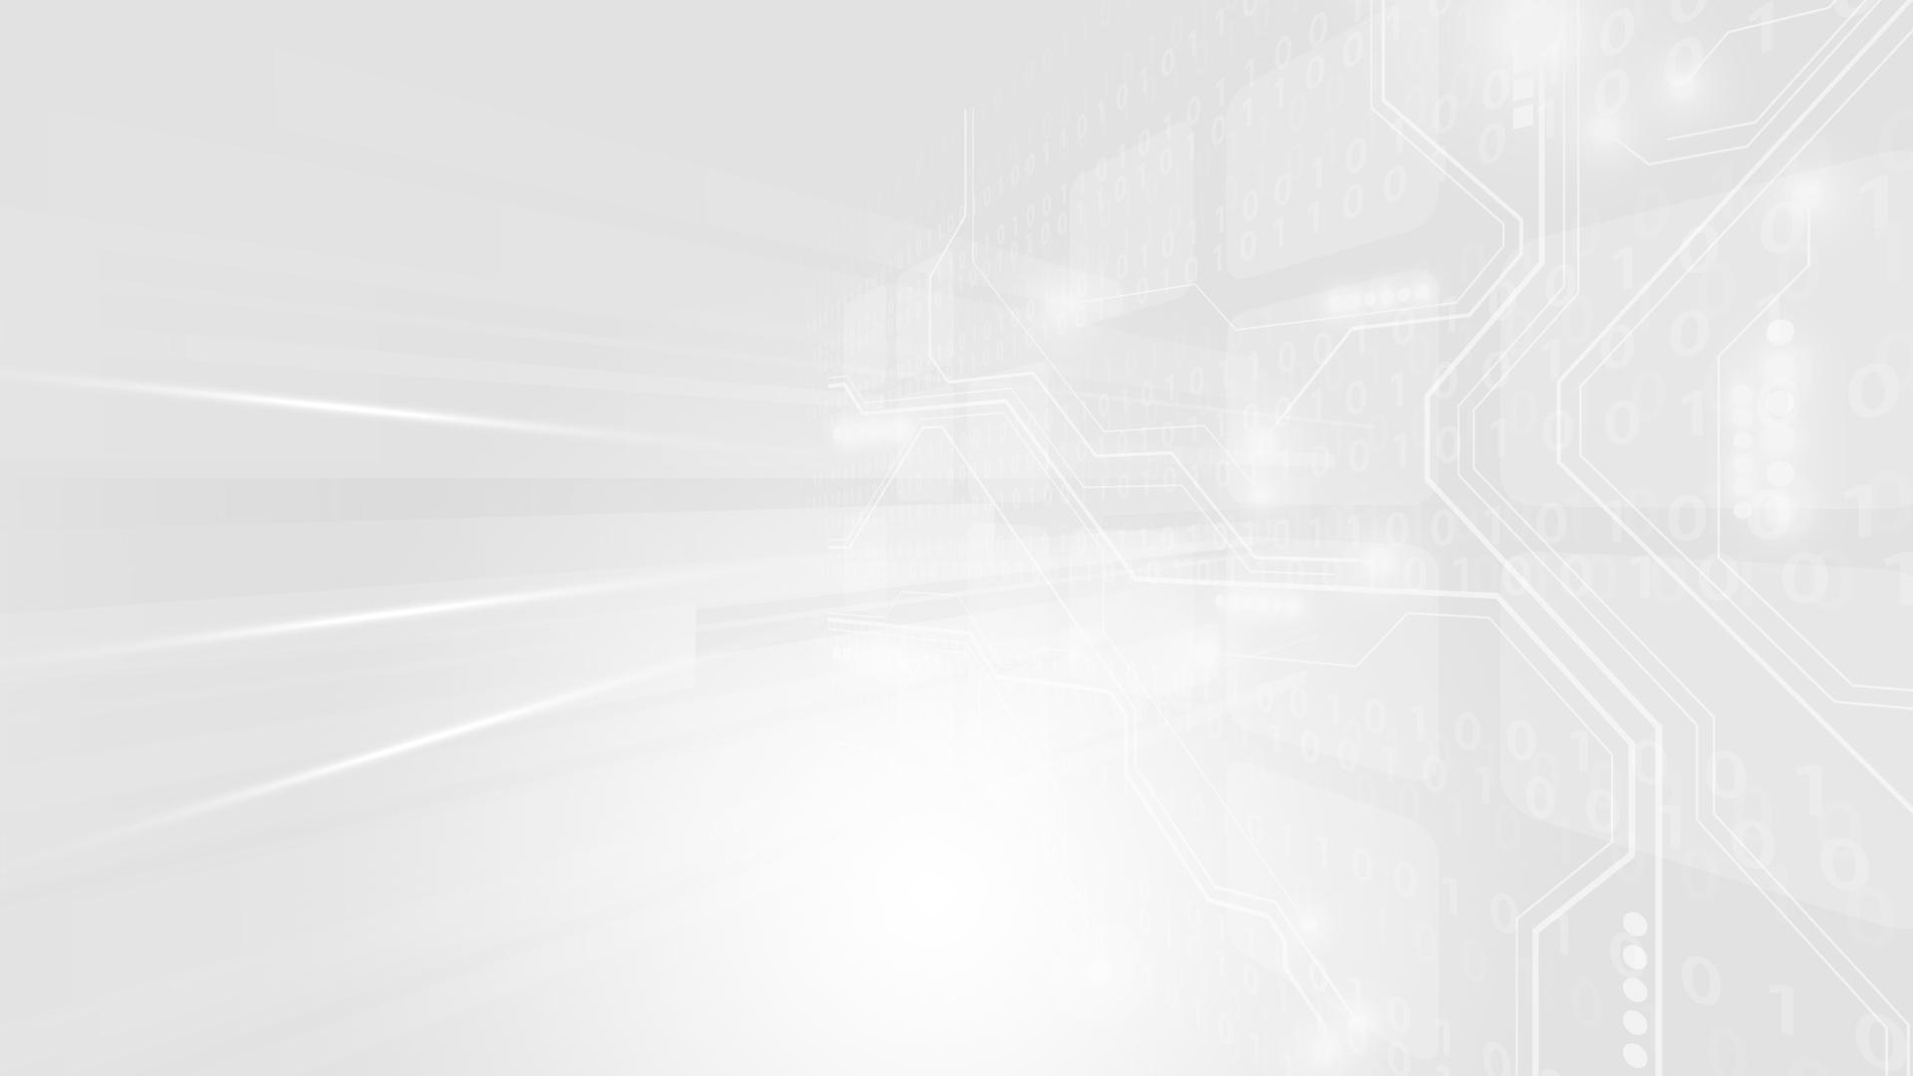
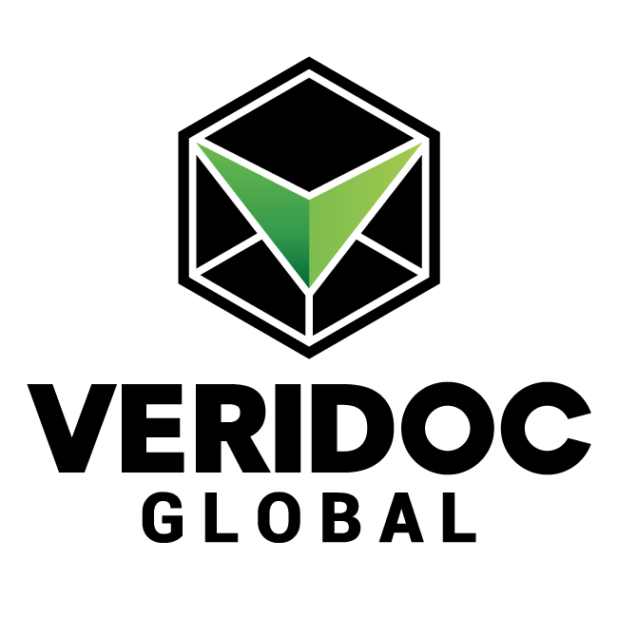
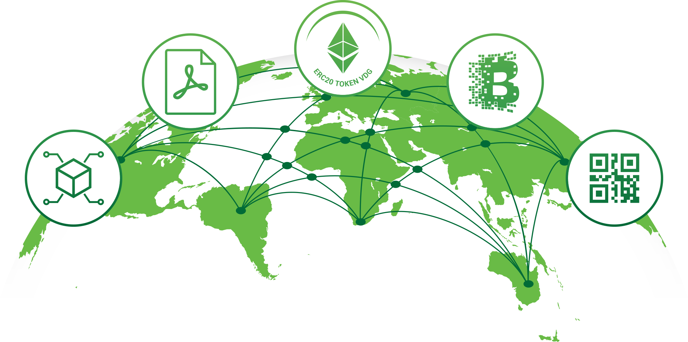
SOLUTION Supply Chain

Slide 2
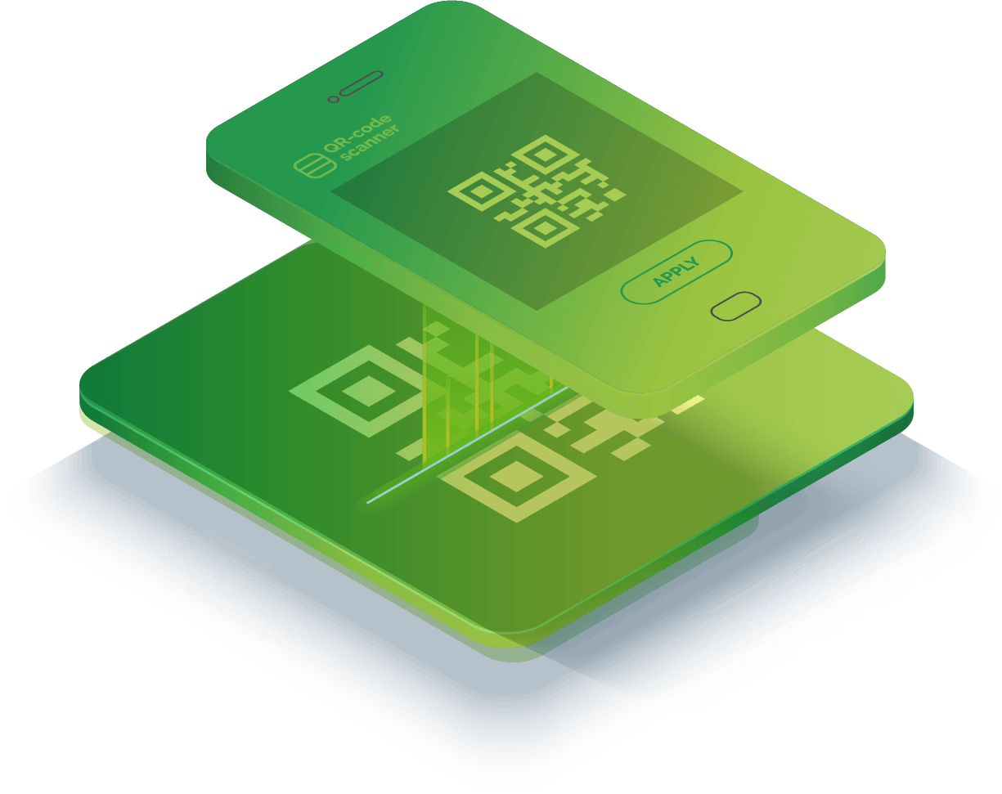
”
OUR AIM IS…
A world without
counterfeit and fraud.
”
WHO WE ARE:
VeriDoc Global is a patent protected Quick Response (QR) Code verification solution using public-key cryptography and Blockchain Technology, providing antifraud / hack proof document verification.
www.veridocglobal.com
VeriDoc Global Solution: Supply Chain

Slide 3
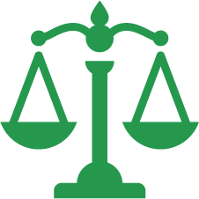
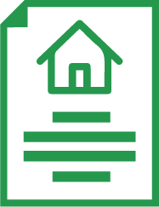
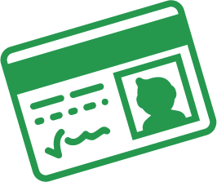
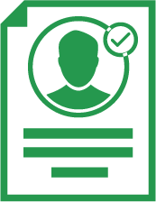
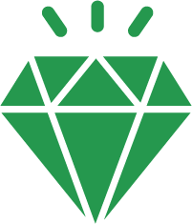
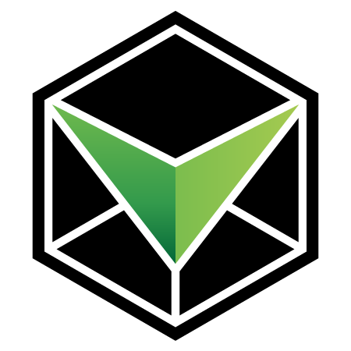
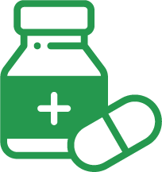
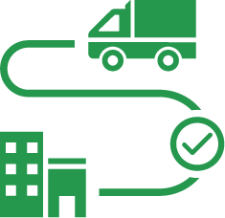
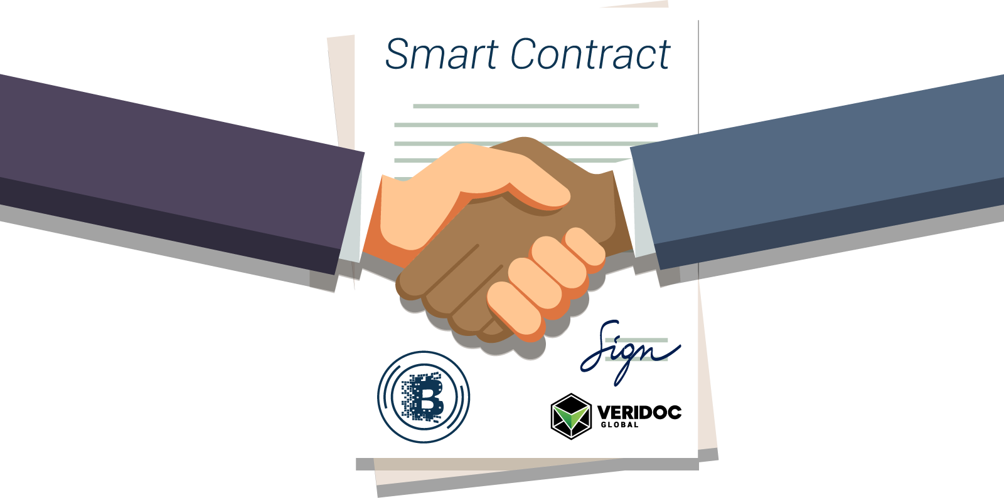
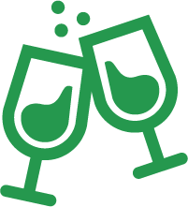
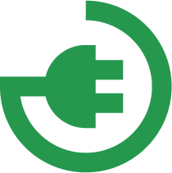
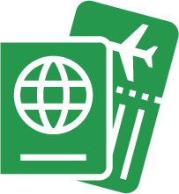
VeriDoc Global solves problems across multiple industries with the implementation of smart contracts.
LEGAL CONTRACTS,
BANK STATEMENTS
LAND TITLES &
MORTGAGE DOCS
IDENTIFICATION &
BIRTH CERTIFICATES
TAX CERTIFICATES & BUSINESS REGISTRATION
PRECIOUS METALS
& LUXURY GOODS
PHARMACEUTICALS
(SERIALIZATION)
SUPPLY CHAINS
FOOD & PRODUCTS
(TRACK & TRACE)
ORIGINAL EQUIPMENT
MANUFACTURER
CERTIFICATES &
TRANSCRIPTS
COLLECTIBLES, TOYS
& ARTWORK
PASSPORTS
www.veridocglobal.com
VeriDoc Global Solution: Supply Chain

Slide 4
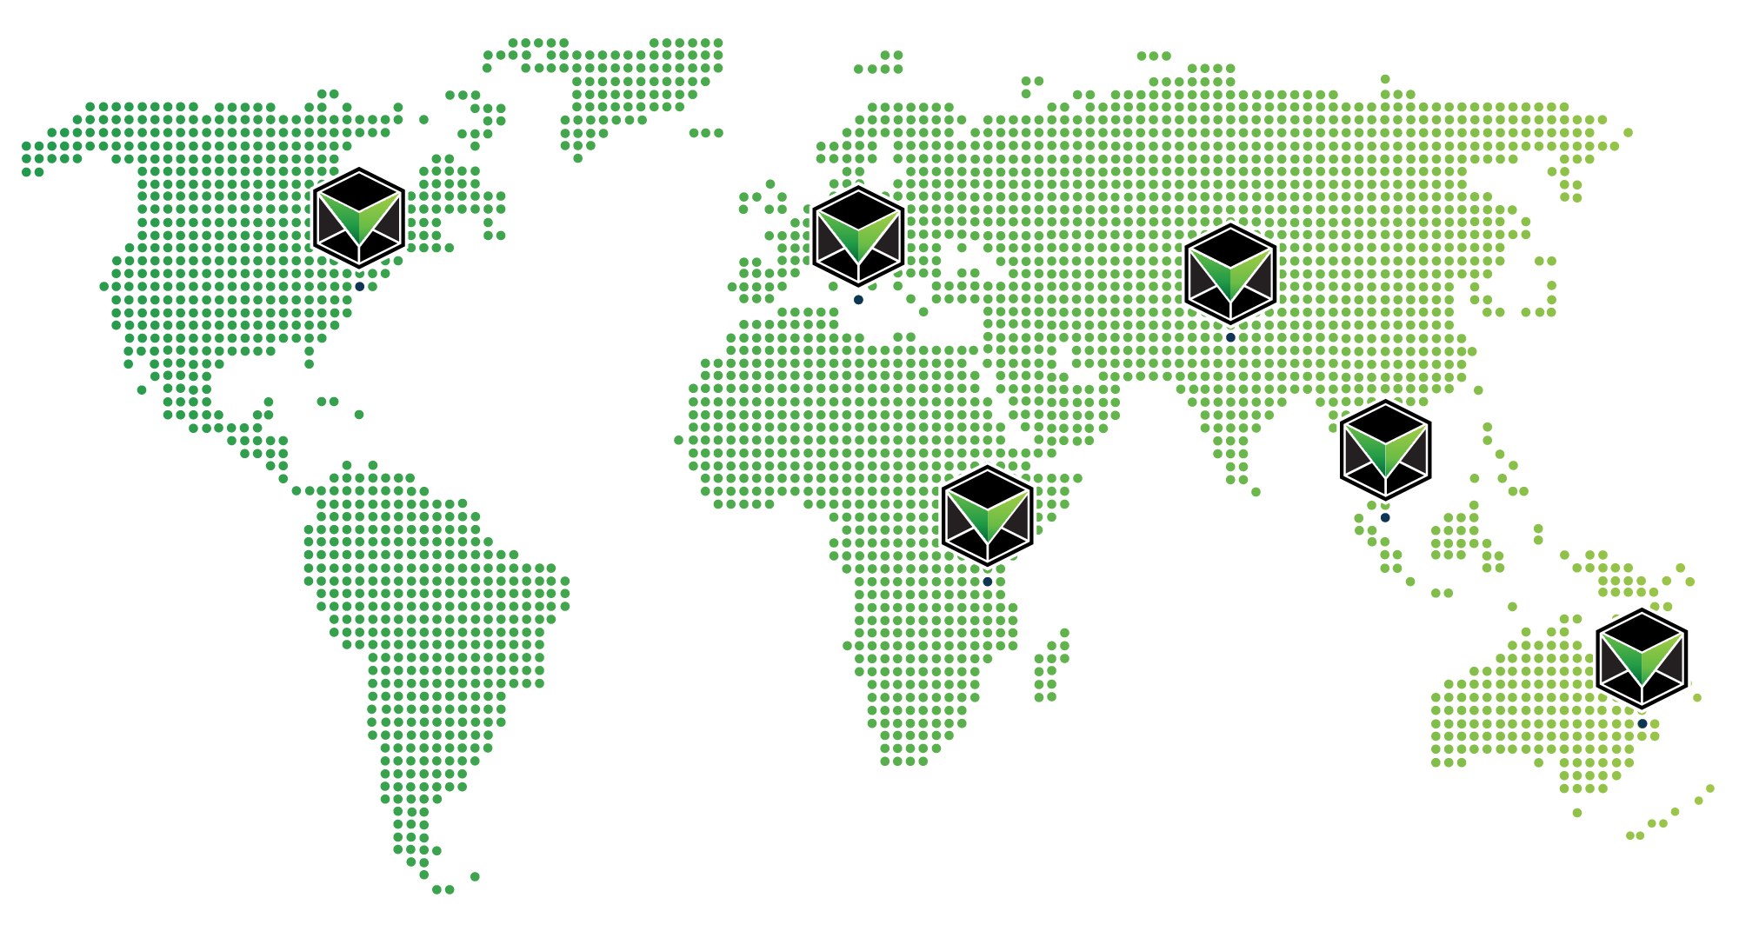
6
WE ARE WORLDWIDE
BRISBANE | NEW YORK CITY | HYDERABAD | SINGAPORE | DAR ES SALAAM | SWATAR
COUNTRIES
120+
TEAM MEMBERS
12
SOLUTIONS
www.veridocglobal.com
VeriDoc Global Solution: Supply Chain

Slide 5
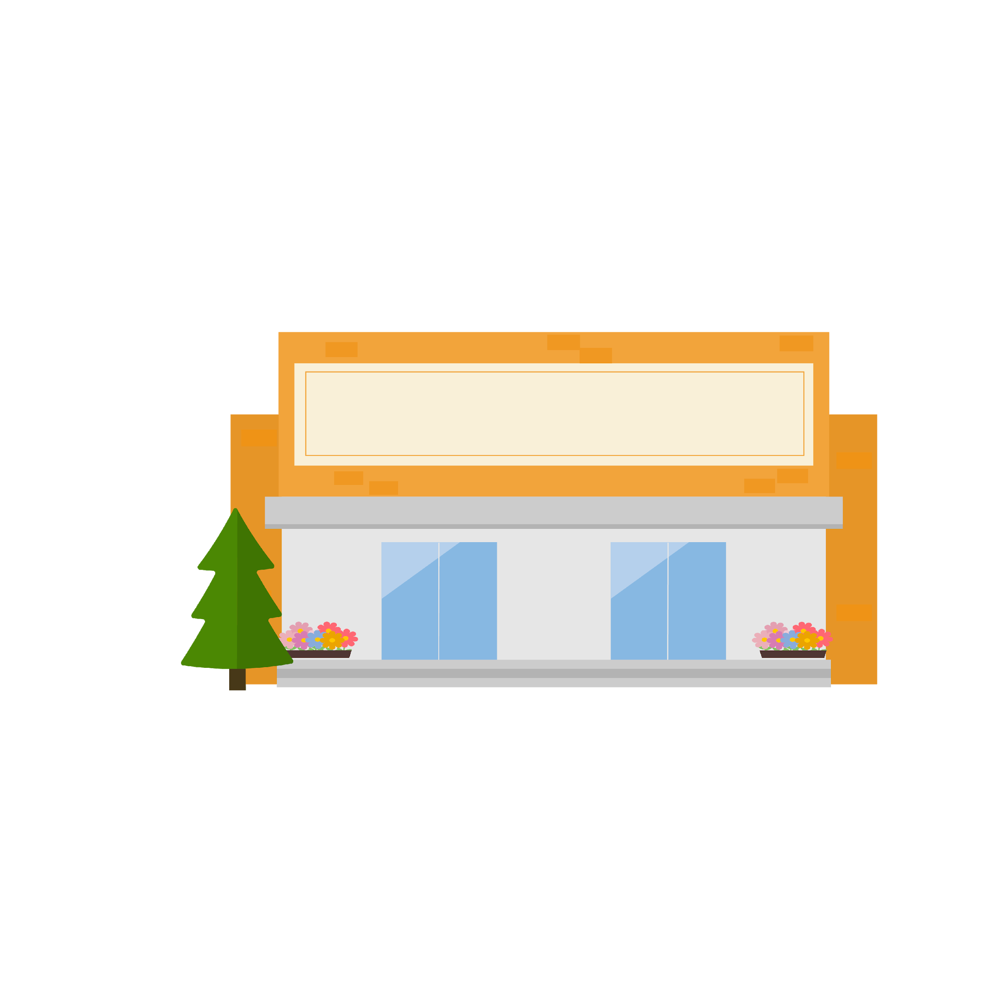
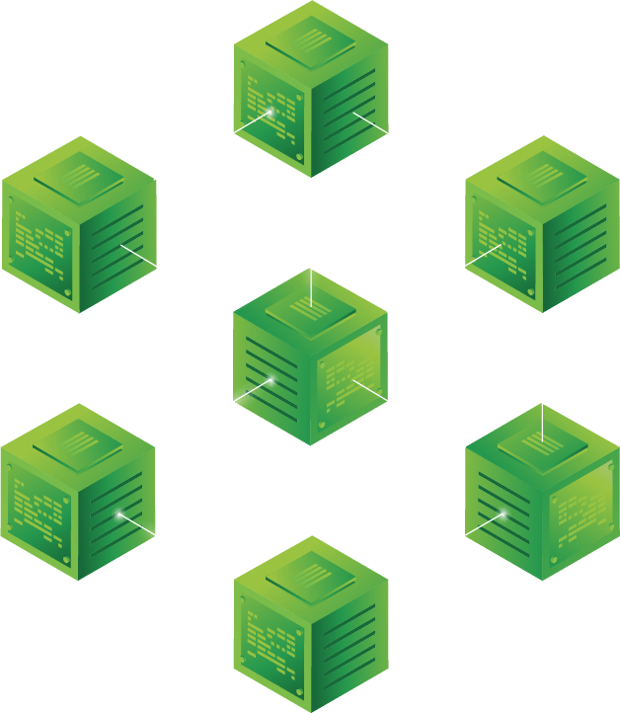
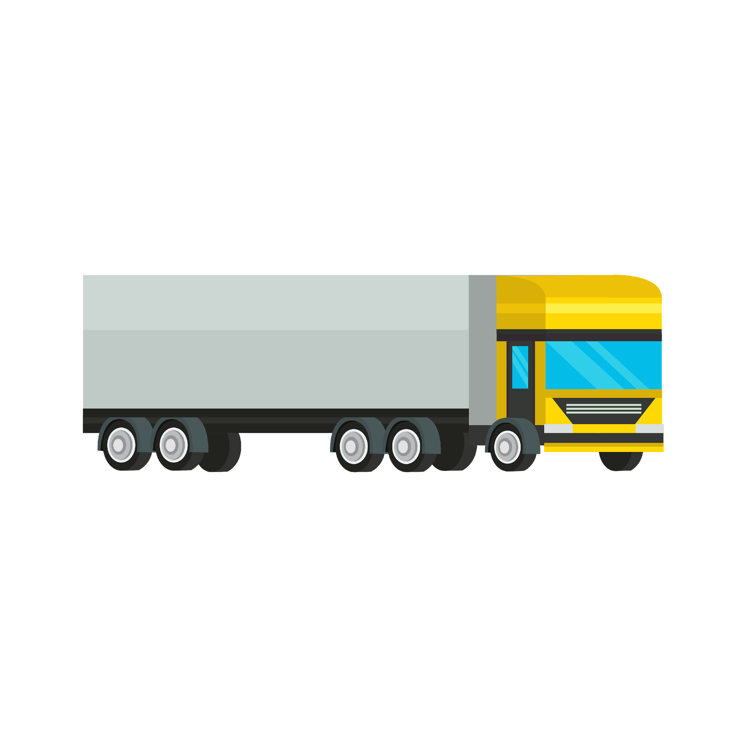
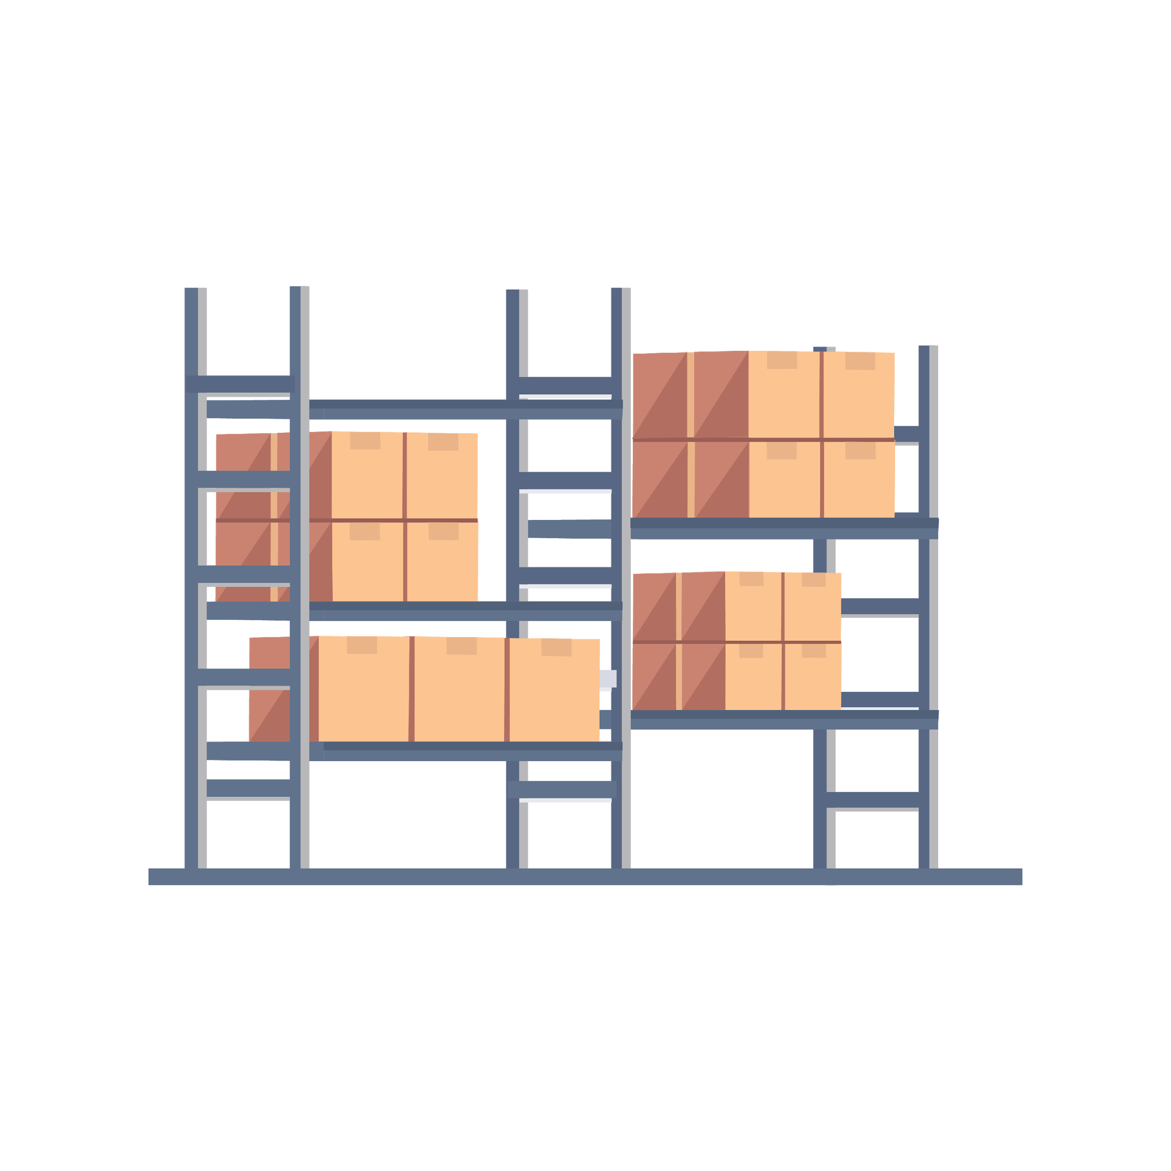
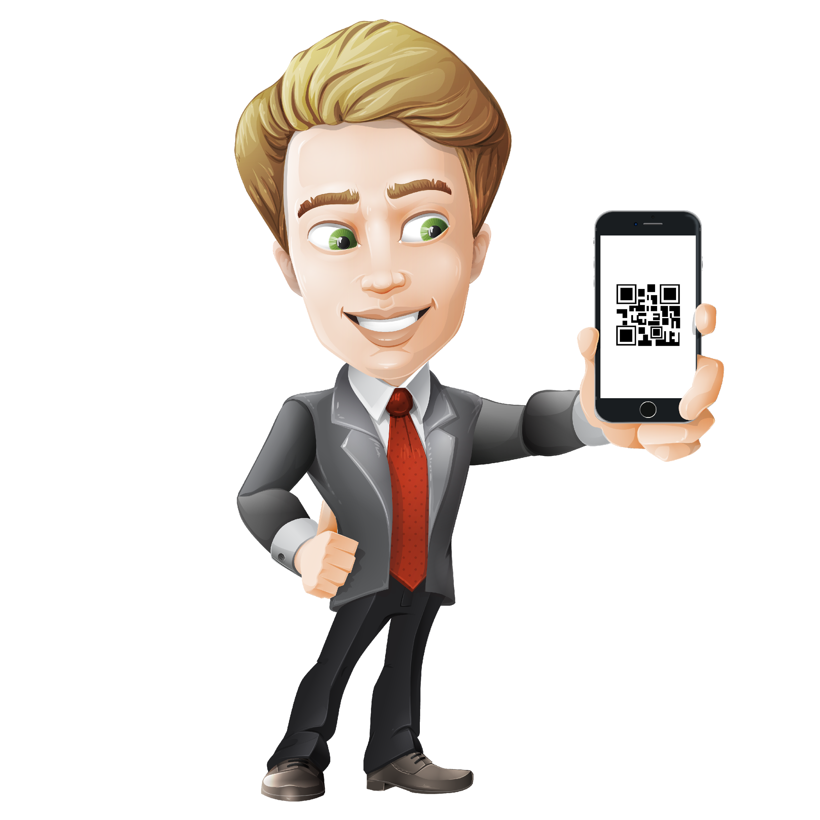
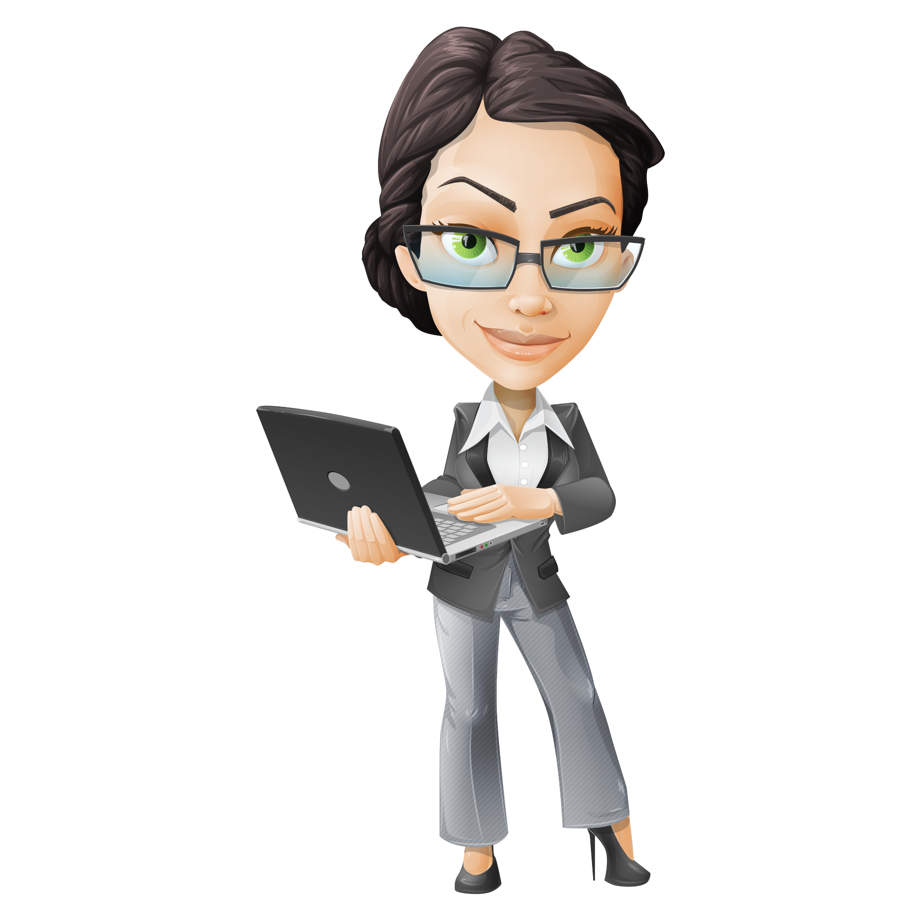
VeriDoc Global has developed a supply chain solution
that leverages blockchain technology and smart contracts. Our system verifies that each step in the supply chain has registered a “digital handshake” that marks exactly when and where the goods have changed hands.
www.veridocglobal.com
VeriDoc Global Solution: Supply Chain

Slide 6
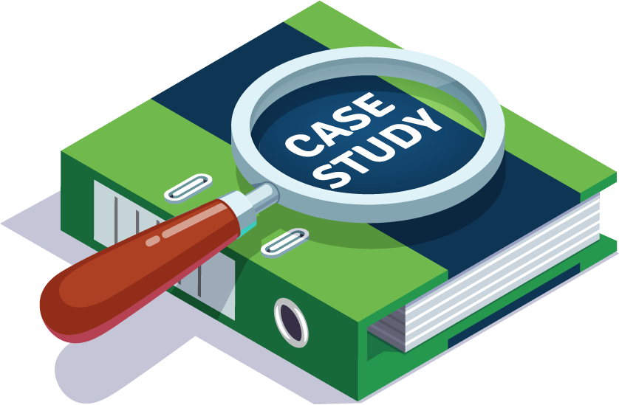
The Problem:
The Solution:
VeriDoc Global has developed a supply chain solution that leverages blockchain technology and smart contracts.
Imagine for a moment that a manufacturer uses the wrong design specs, a supplier mixes up two different orders or a raw material causes a bad batch of products that need to be recalled. On top of that, billions of dollars in cash flow are now tied up while the problem is being rectified plus the 60-day payment terms.
Supply chains can be complicated.
CASE STUDY.
The effects of poorly managed supply chains continue to trouble businesses today. On May 10th of 2016, hoverboards were exploding all over the world. A number of incidents of the boards catching fire led to major retailers such as Amazon and Target issuing refunds and telling customers to trash them. Airlines were banning them and some cities were even banning hoverboards from roads and sidewalks. It is was later found that the batteries in the boards were defective and causing the fires.
Our system verifies that each step in the supply chain has registered a “digital handshake” that marks exactly when and where the goods have changed hands. This makes it clear who is liable for products every step of the way.
www.veridocglobal.com
VeriDoc Global Solution: Supply Chain

Slide 7
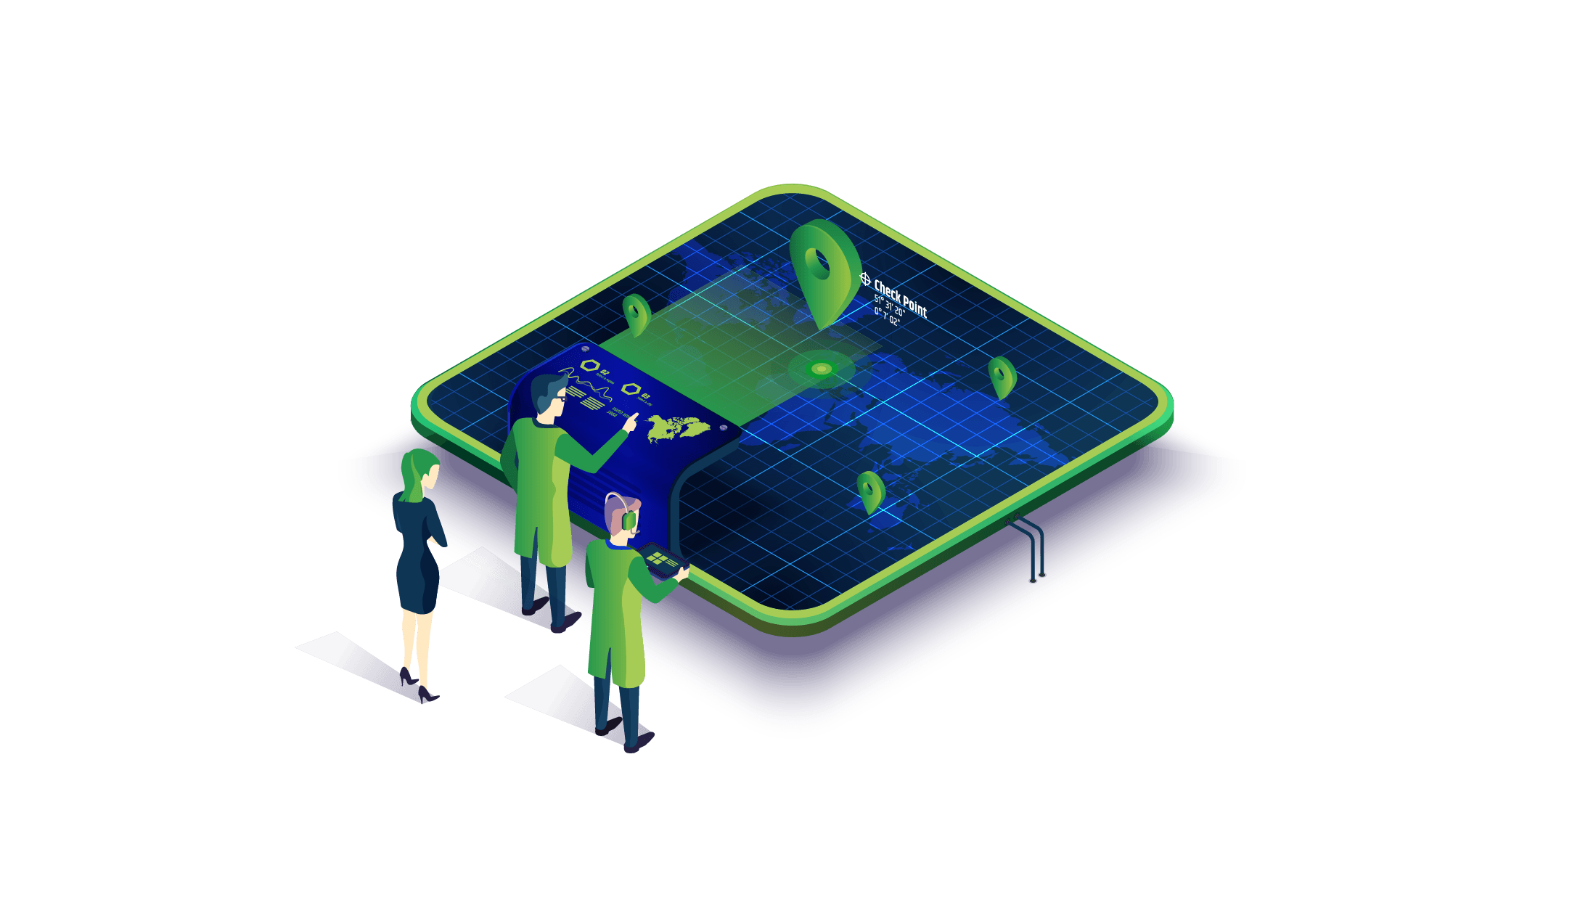
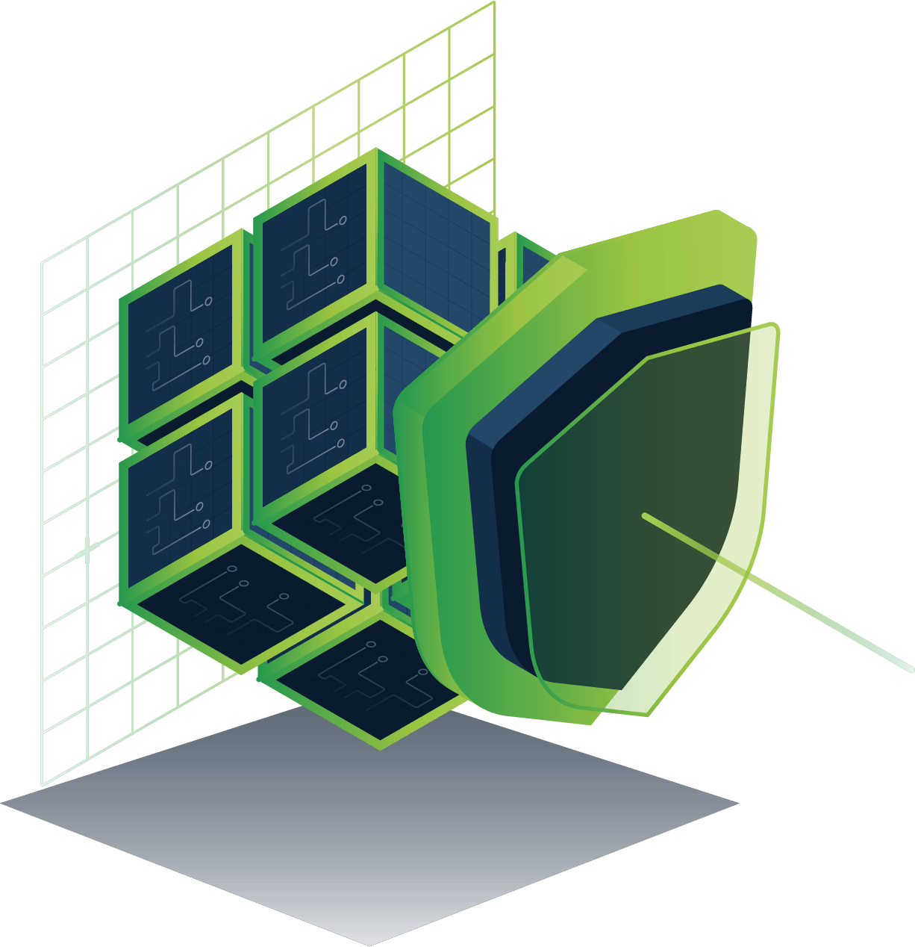
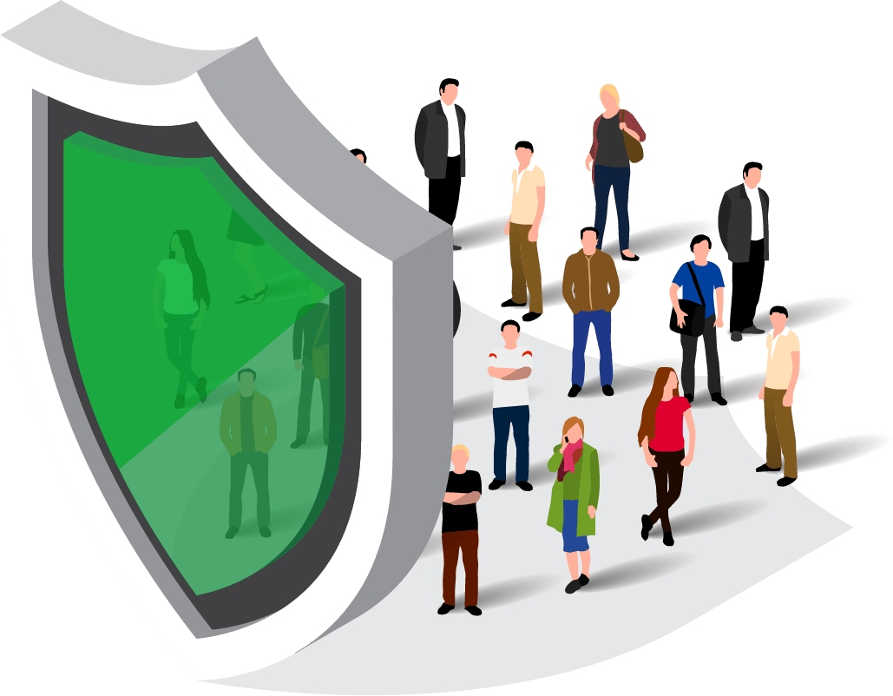
KEY FEATURES
FOREFRONT OF SECURITY
INCREASED TRANSPARENCY
INCREASED PUBLIC SAFETY
Data is immutable on blockchain and can’t be breached via an attack on a single server or database.
Governments and businesses know exactly when and where the goods have changed hands.
Increases the speed in which problems can be identified and products can be recalled.
www.veridocglobal.com
VeriDoc Global Solution: Supply Chain

Slide 8
VERIDOC GLOBAL SOLUTION
VeriDoc Global has developed a solution that involves embedding a QR code on an item with a unique digital hash inside the QR code. The hash holds a string of information that is then placed on the blockchain network for security, verification and most important end user validation.
Using a QR code reading app, customers can scan the QR code on the item once it has been delivered to them to verify the authenticity of items.
Throughout the shipping process, the QR code can be updated with information verifying when and where the product has changed hands.
Additional information can be added to the QR code by the manufacturer anytime in case of a product recall.
www.veridocglobal.com
VeriDoc Global Solution: Supply Chain

Slide 9
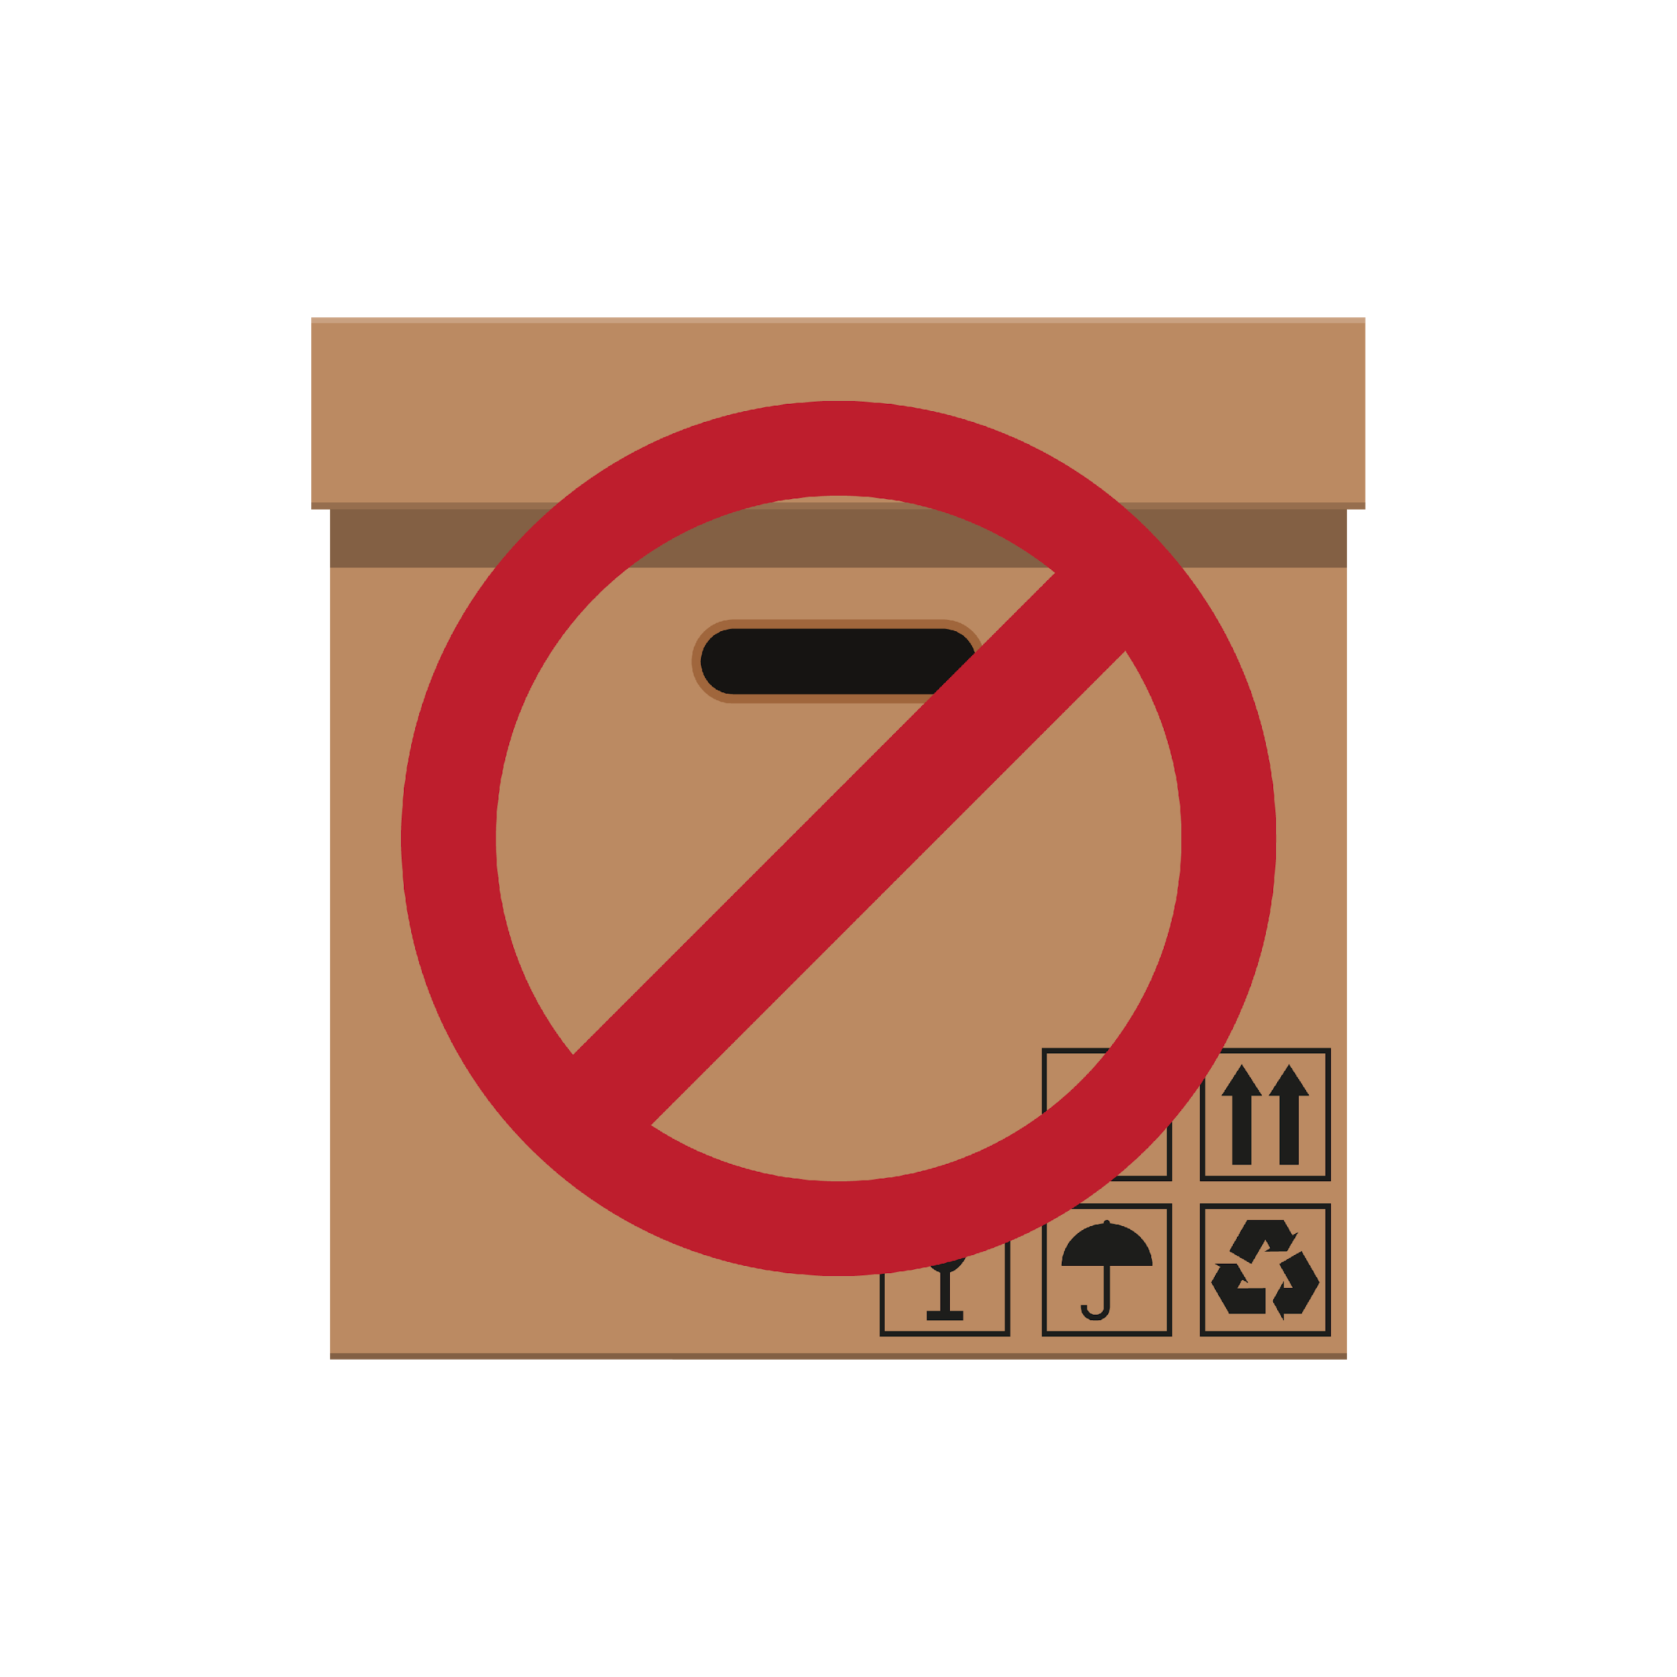
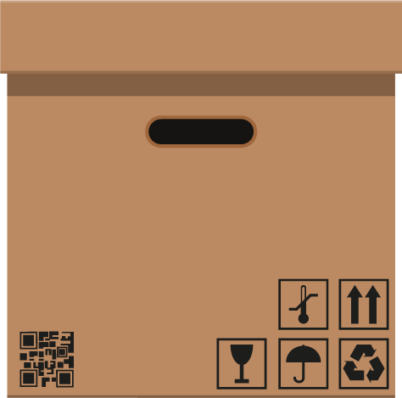
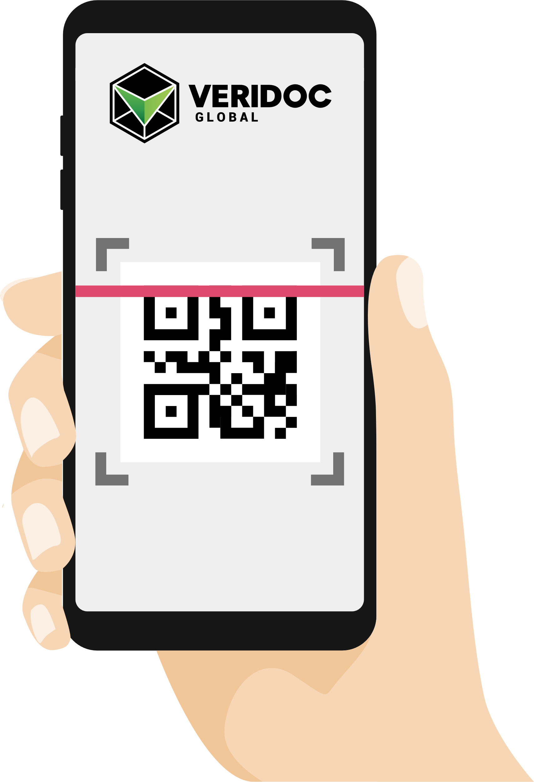
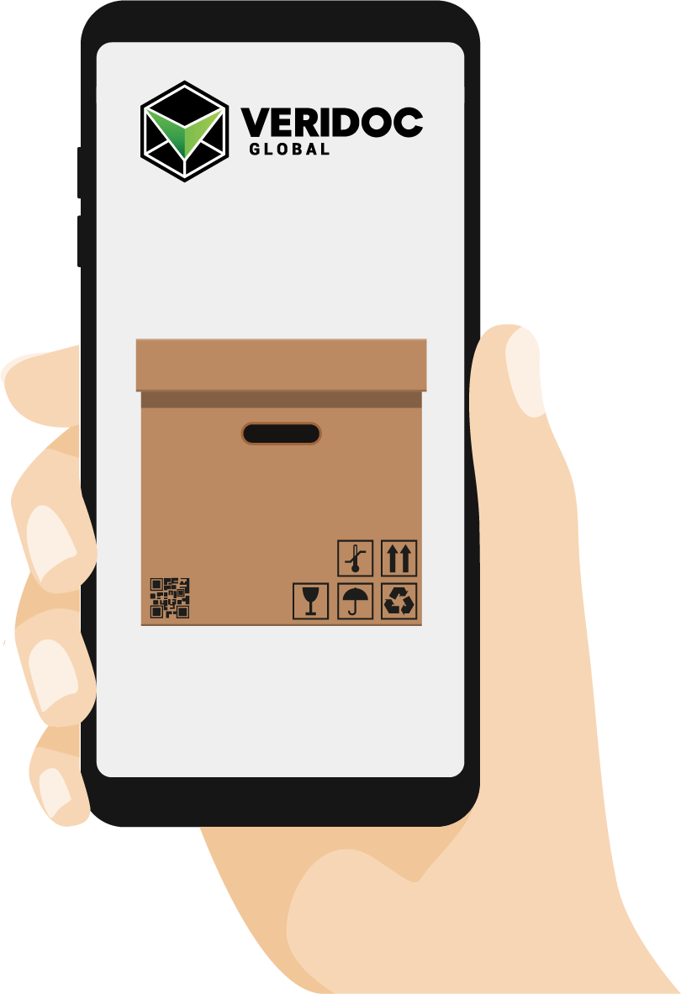
HOW DOES IT WORK?
QR READING APP
ORIGINAL
FAKE
Using any QR reading app, hold your device over the QR code of item and it will scan it.
The app verify that each step in the supply chain has registered a “digital handshake” that marks exactly when and where the goods have changed hands, and allows customer to verify the authenticity of product.
www.veridocglobal.com
VeriDoc Global Solution: Supply Chain

Slide 10
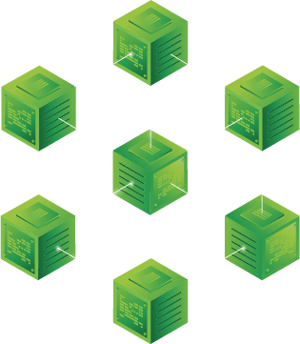
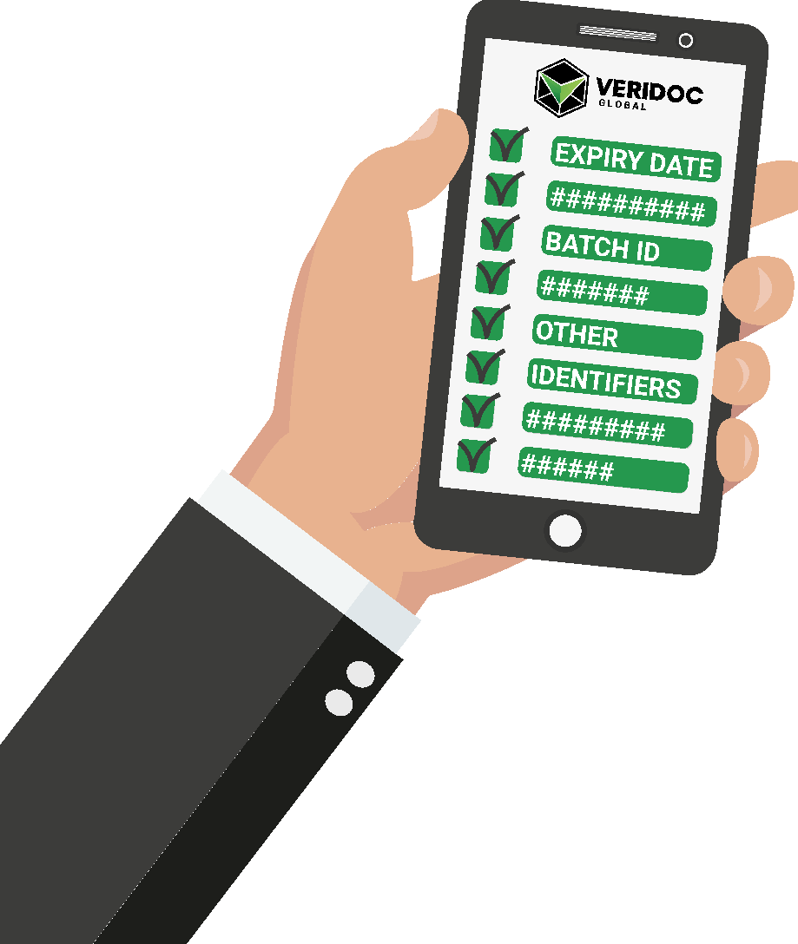
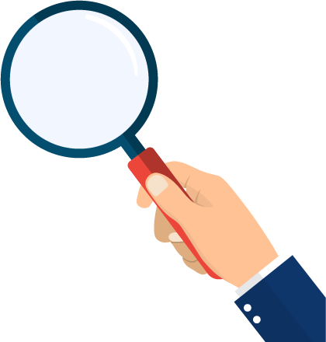
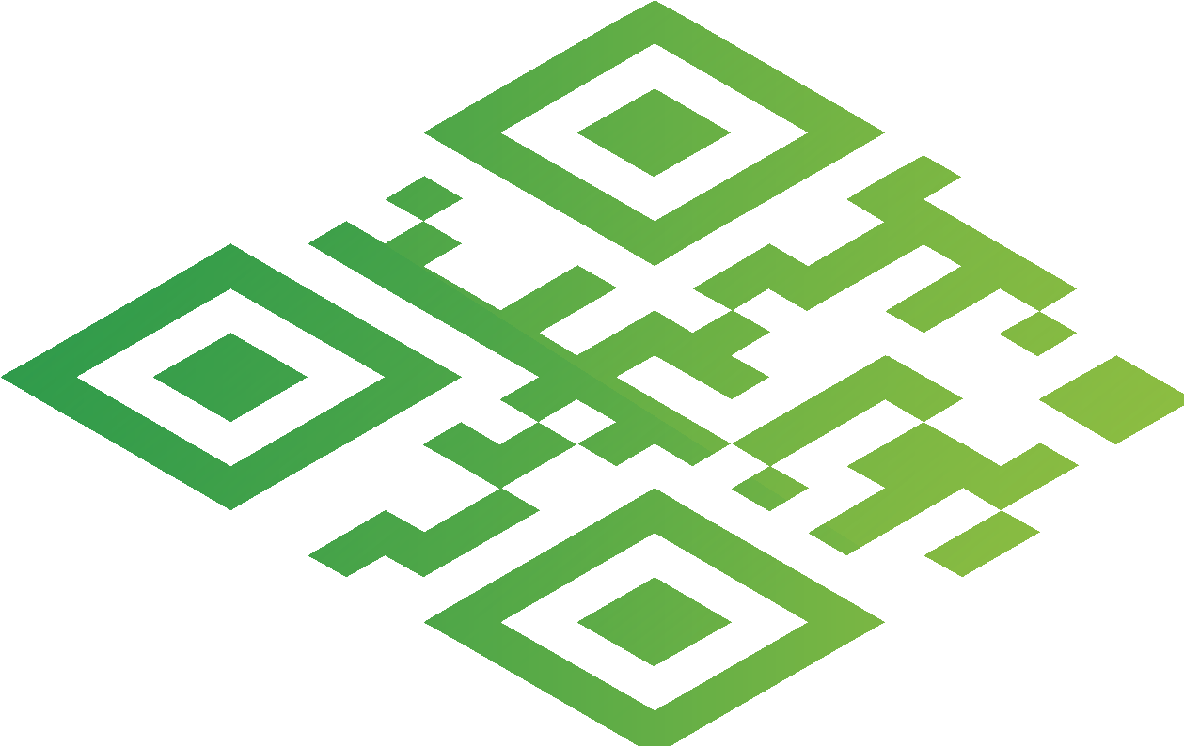
HOW DOES THE HASH VALUE WORK?
The system looks at the hash value inside the QR code.
Then checks the hash value on the blockchain.
The system displays information and identifiers that are linked to the hash value.
www.veridocglobal.com
VeriDoc Global Solution: Supply Chain

Slide 11
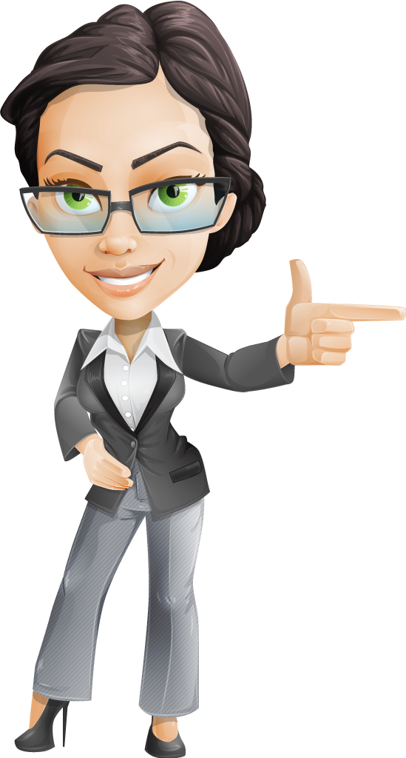
How does the QR Code work?
QR codes are a type of matrix barcode or two-dimensional barcode.
A standard QR code can hold up to 3Kb of data, compared to a standard barcode which holds less than 100 characters.
VeriDoc Global uses a unique digital hash value that is stored on the QR code. When a QR code reader is used to scan the QR code, the system looks at the unique hash value and then checks that value on the blockchain. The system verifies that the hash value exists on the blockchain and then displays the information that is linked to the hash value.
This significantly improves supply chain management because blockchain technology prevents the data and the QR code from ever being changed or removed.
www.veridocglobal.com
VeriDoc Global Solution: Supply Chain

Slide 12
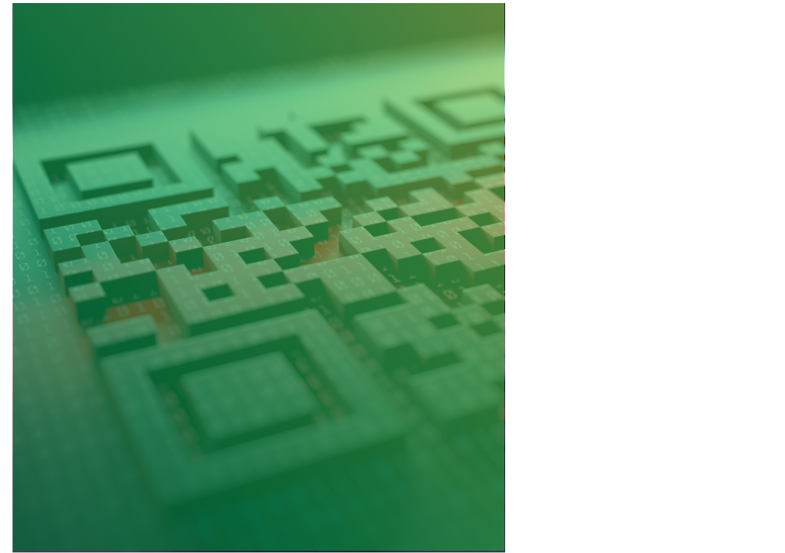
THE VERIDOC GLOBAL PROTOCOL DETERS COUNTERFEITERS FROM COPYING A QR CODE AND ALSO PREVENTS THEM FROM USING THEIR OWN QR CODES.
What if someone copies the QR code?
Success factors:
Each document has a unique hash value and can’t be verified in two places at once. If the data collected reports this occurrence, the QR code for the banknote can be blocked or put into quarantine.
The VeriDoc Global QR code reader allows the RBA to have 100% control over the QR codes that are verifiable. Counterfeiters who try to replicate the process with their own QR codes will not be able to get past the security checks that take place using the VeriDoc Global app.
www.veridocglobal.com
VeriDoc Global Solution: Supply Chain

Slide 13
What About
RFID Chips ?
There is no doubt that RFID technology has many benefits, however RFID also has its vulnerabilities.
Some of the reasons why RFID technology is so vulnerable are:
RFID chips use “contactless technology” which means that data is transferred over the airwaves. There is plenty of evidence that shows that RFID tags can and have been hacked.
RFID tags can be read without your knowledge. Unlike magnetic strips and QR codes which need to be swiped or scanned, anyone with an RFID tag reader can read your RFID tag without you knowing.
RFID tags can be read from greater distances. Most RFID systems are designed so that the distance between the tag and the reader are kept to a minimum, however a high gain antenna can be used to read tags from greater distances, which leads to privacy issues
www.veridocglobal.com
VeriDoc Global Solution: Supply Chain

Slide 14
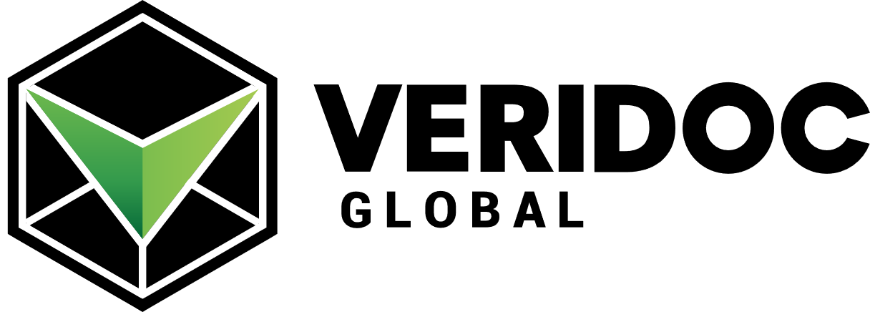
SUPPLY CHAIN
MANUFACTURER
AND CUSTOMER FLOW
www.veridocglobal.com
VeriDoc Global Solution: Supply Chain

Slide 15
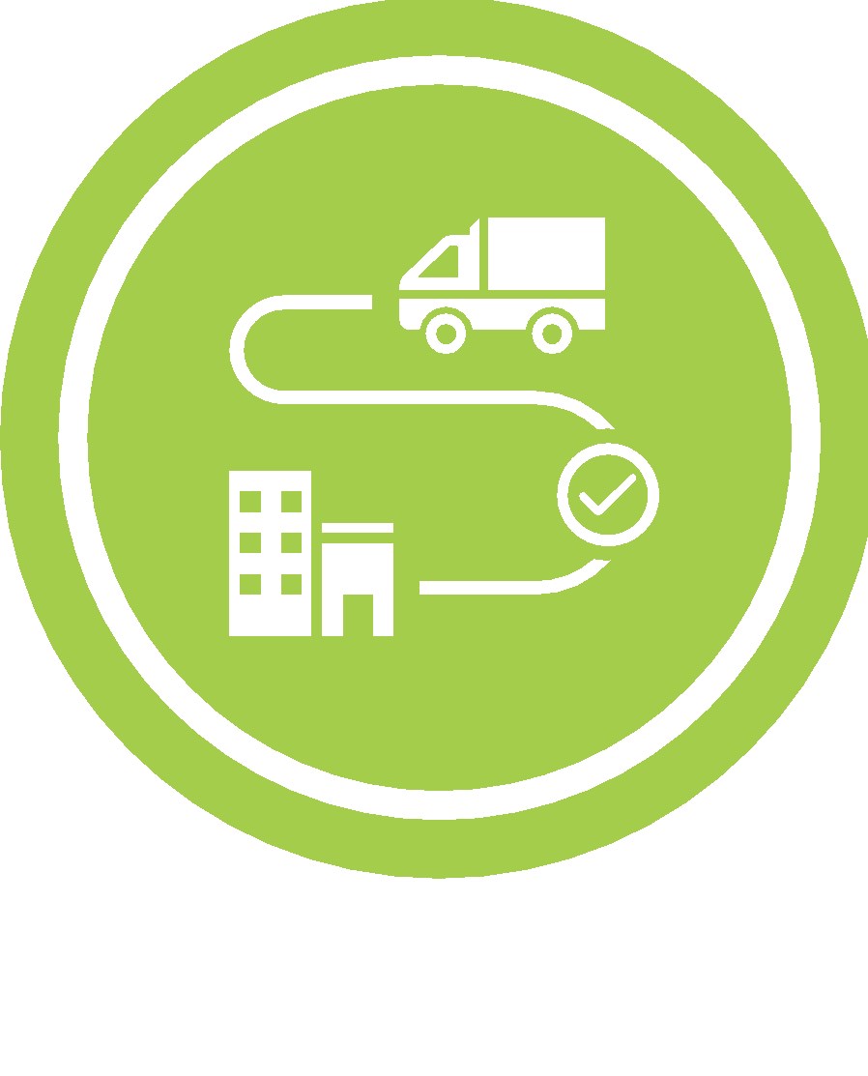
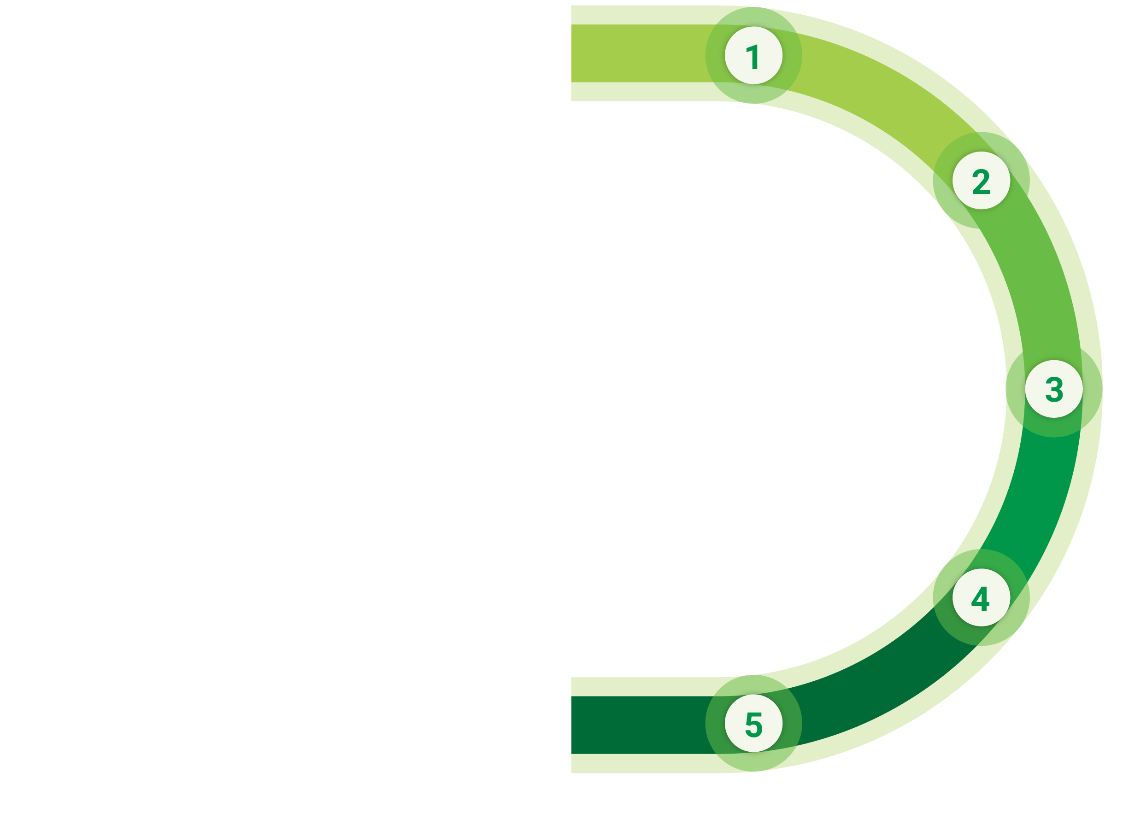
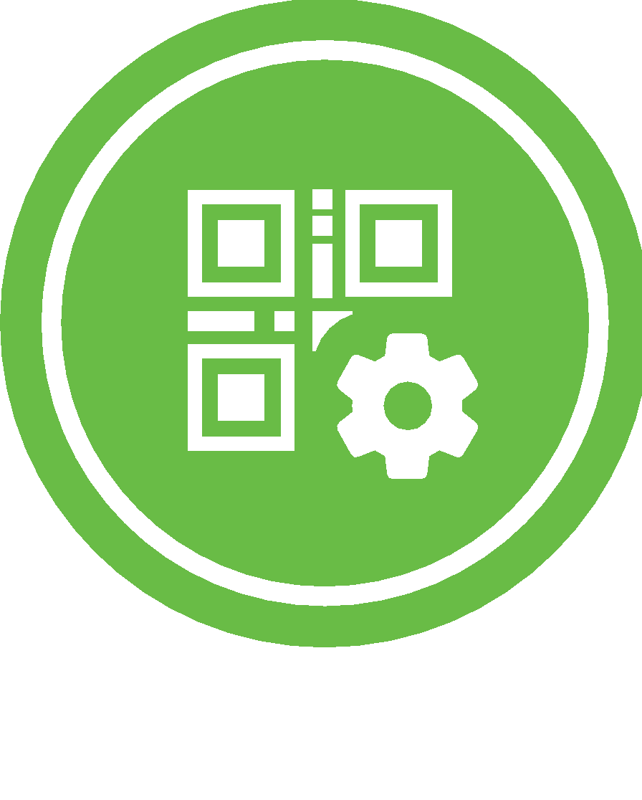
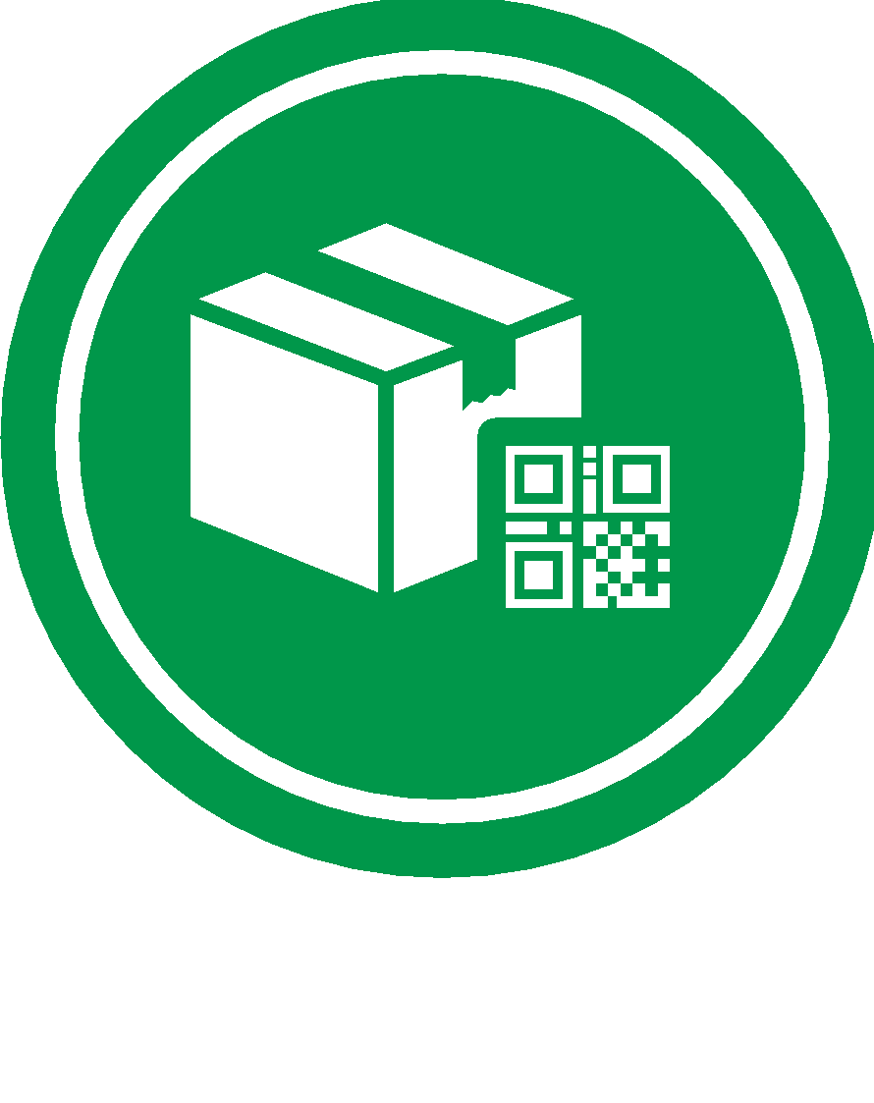
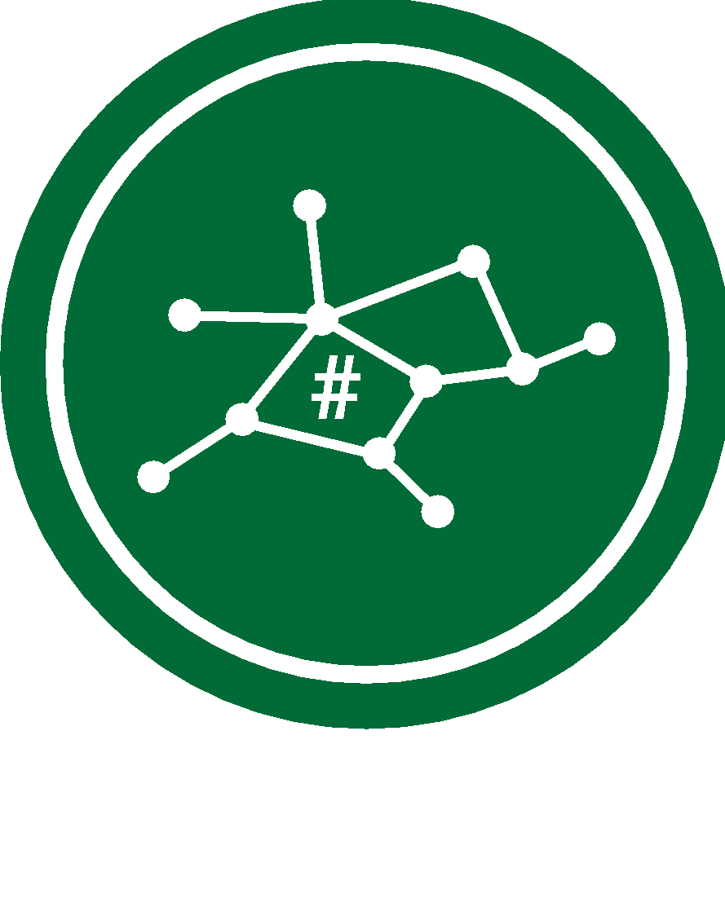
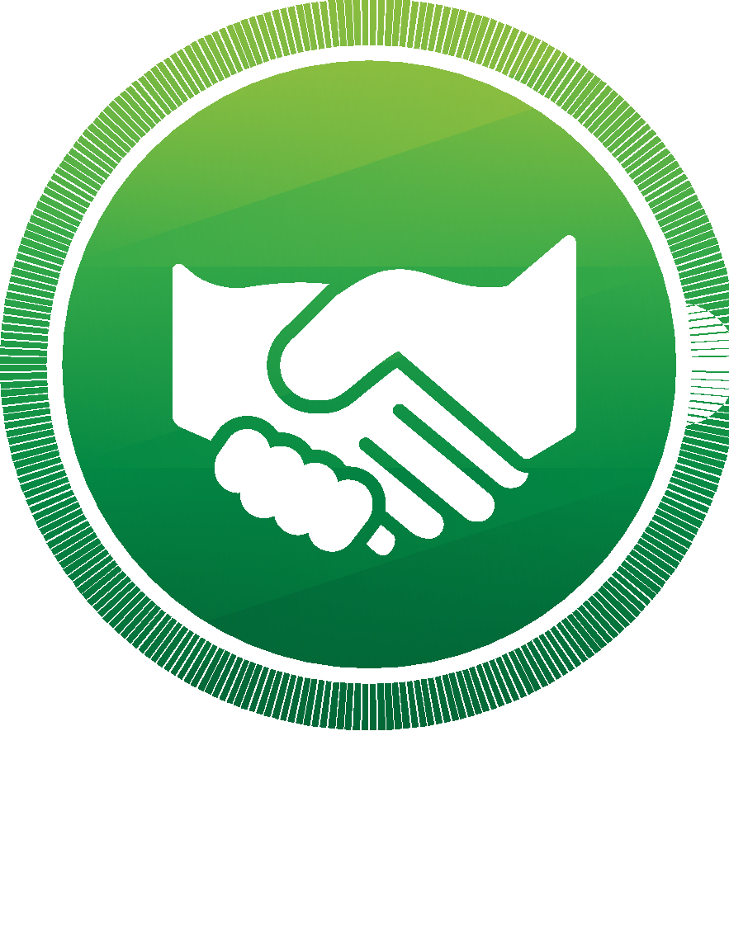
CREATE AN ITEM
Manufacturer creates an item.
GENERATE QR CODE
VeriDoc Global generates a QR code that contains a unique hash value with information about the item.
SUPPLY CHAIN
MANUFACTURER FLOW
QR CODE ADDED
TO THE ITEM
The QR code is added to the item.
GENERATE UNIQUE
HASH VALUE ON BLOCKCHAIN
The information is placed on the blockchain.
DIGITAL HANDSHAKE
VeriDoc Global verifies each step in the supply chain registering a “digital handshake” that marks exactly when and where the goods have changed hands.
www.veridocglobal.com
VeriDoc Global Solution: Supply Chain

Slide 16
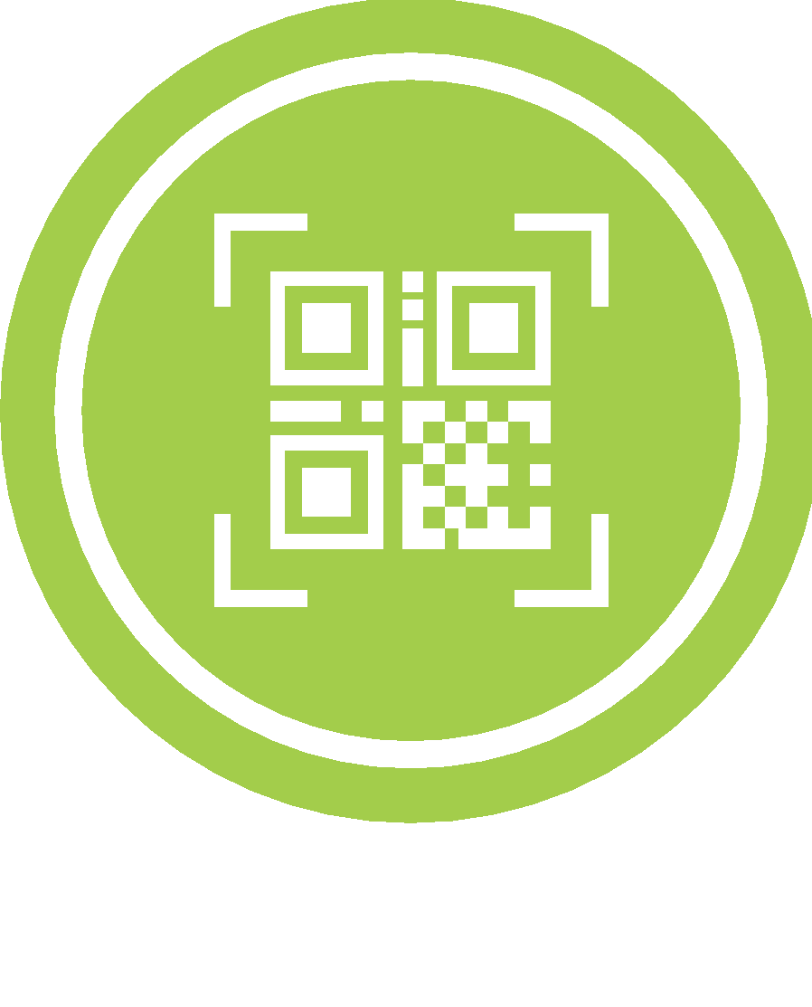
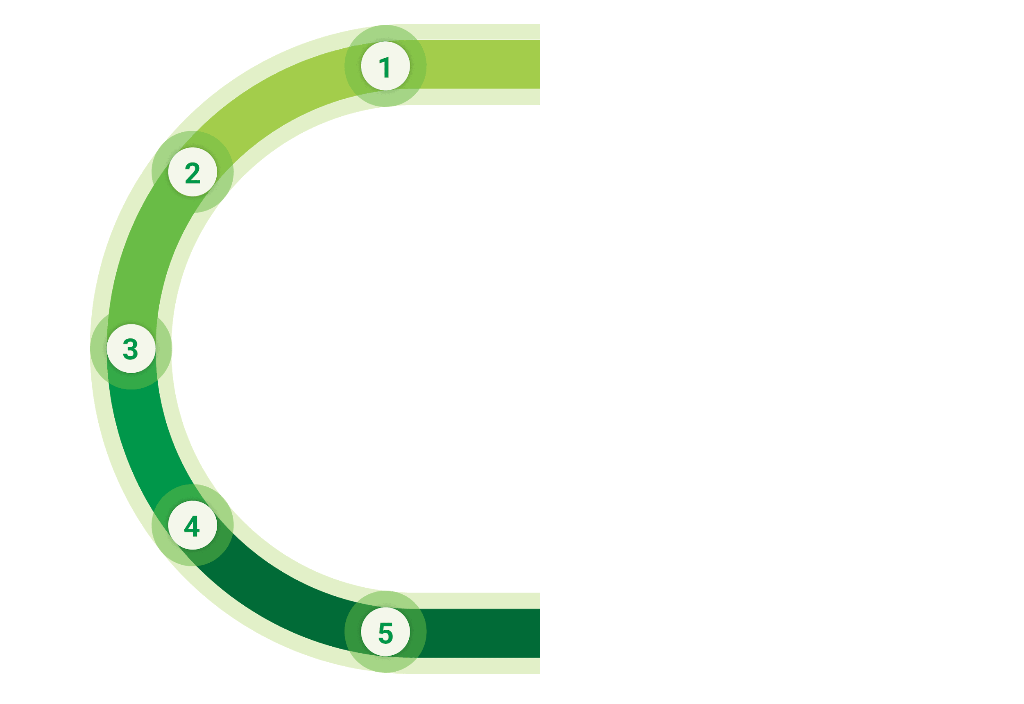
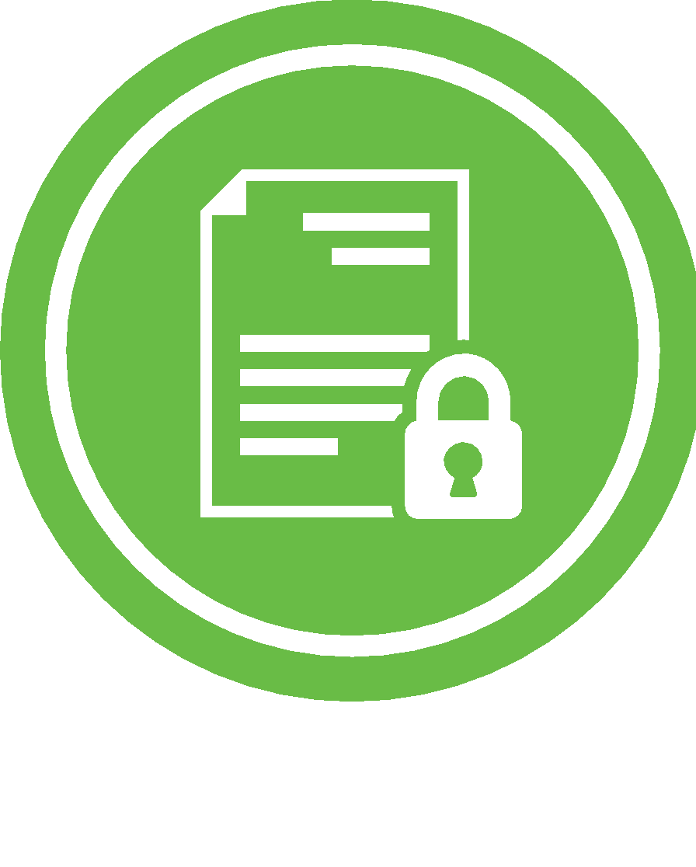
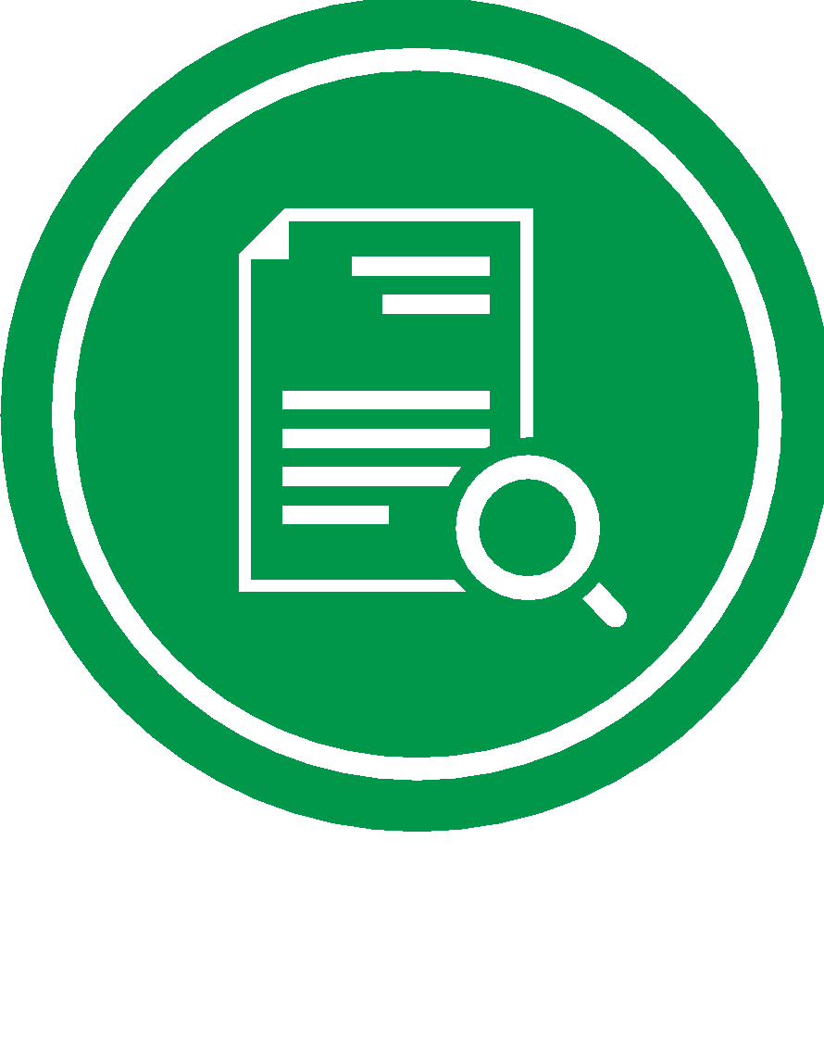
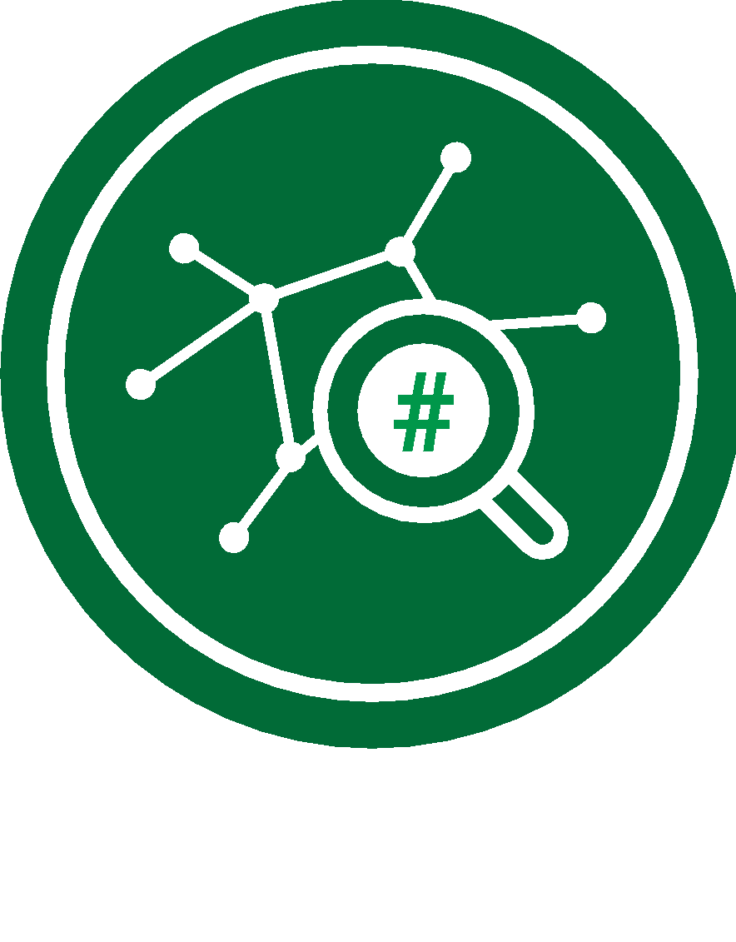
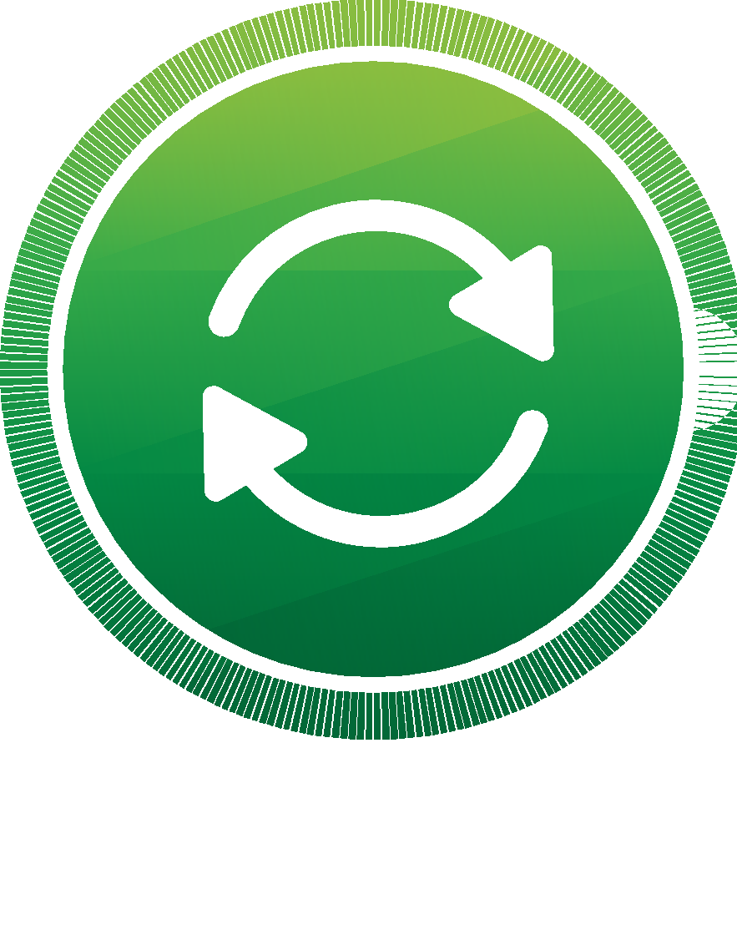
QR CODE READER
Item is scanned using a QR code reader.
PREVIEW ORIGINAL INFORMATION
Customer is redirected to a secure page that displays information about the item.
SUPPLY CHAIN
CUSTOMER
FLOW
VISUAL INSPECTION
Customer validates the authenticity of the item by visual inspection.
VALIDATE HASH VALUE
ON BLOCKCHAIN
Customer may validate the unique hash value on the blockchain and verify that the digital signatures are identical.
INFORMATION UPDATE
Additional information can be added to the QR code by the manufacturer anytime in case of a product recall (optional).
www.veridocglobal.com
VeriDoc Global Solution: Supply Chain

Slide 17
THE FUTURE OF Supply Chain Security
www.veridocglobal.com
VeriDoc Global QR Code Reader App Available Now

