Slide 1
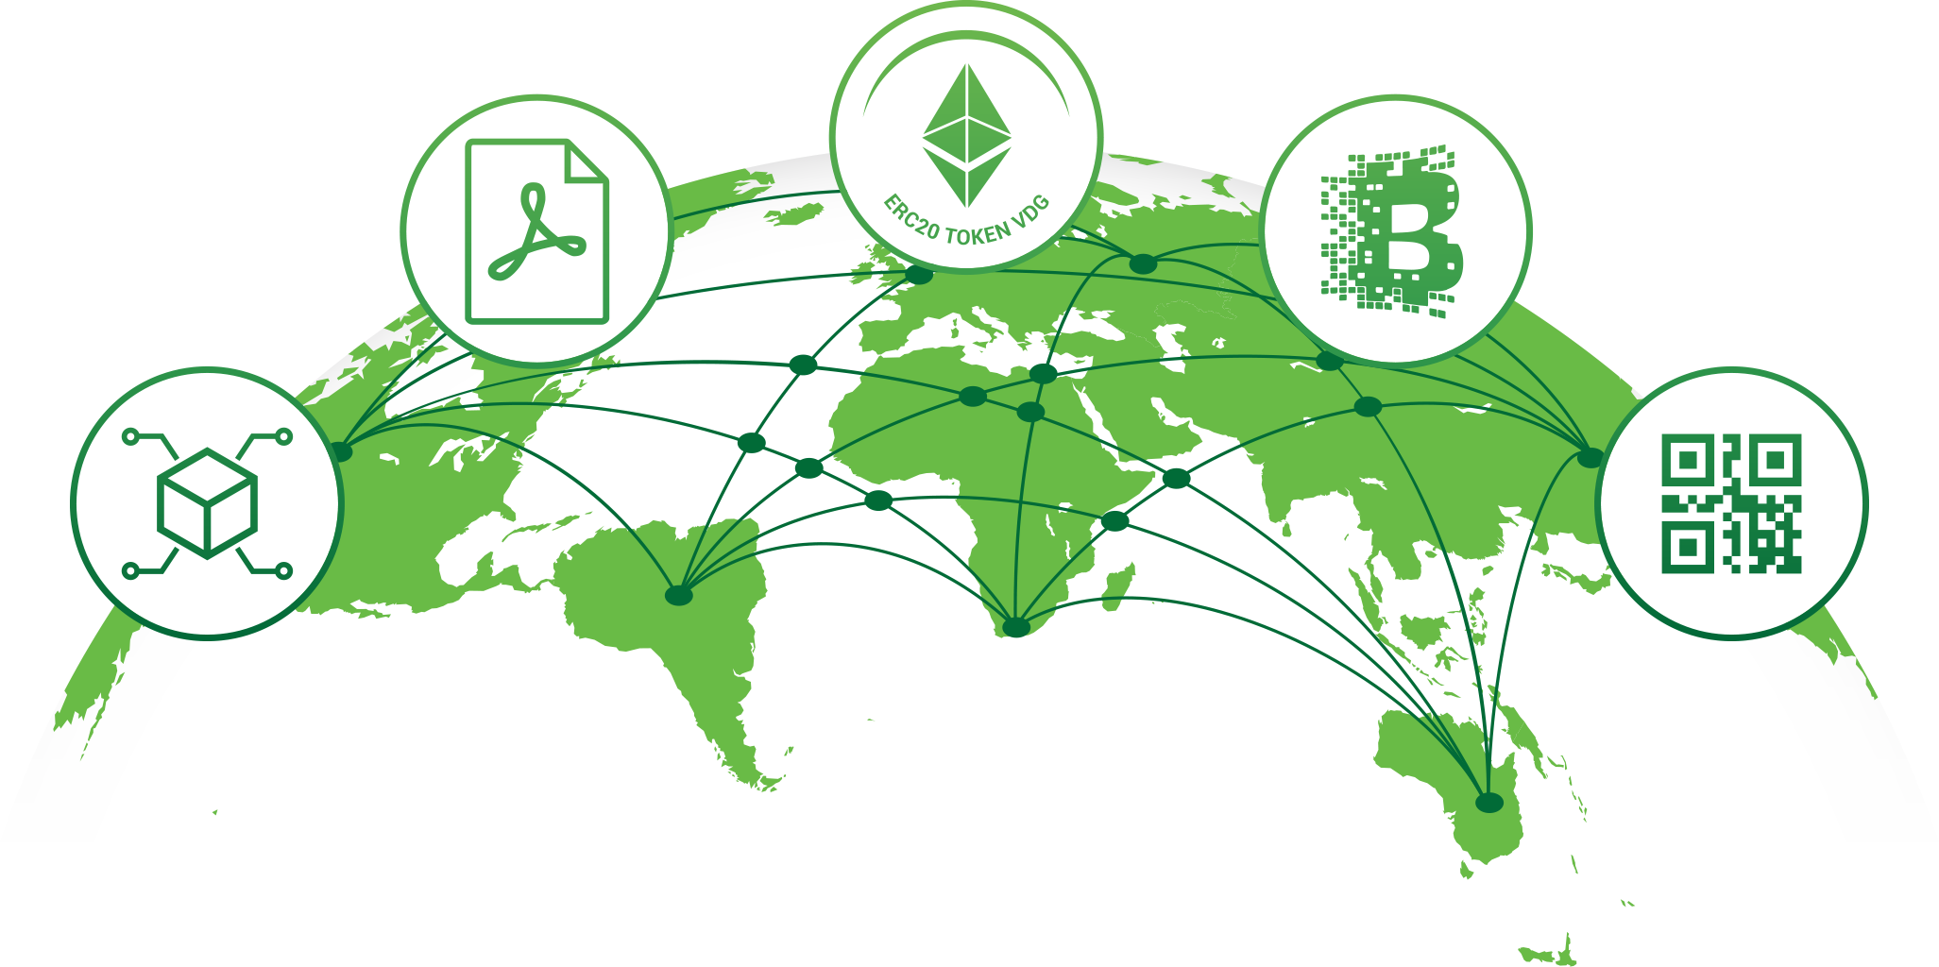
SOLUTION ID CARDS AND DRIVER’S LICENSES

Slide 2
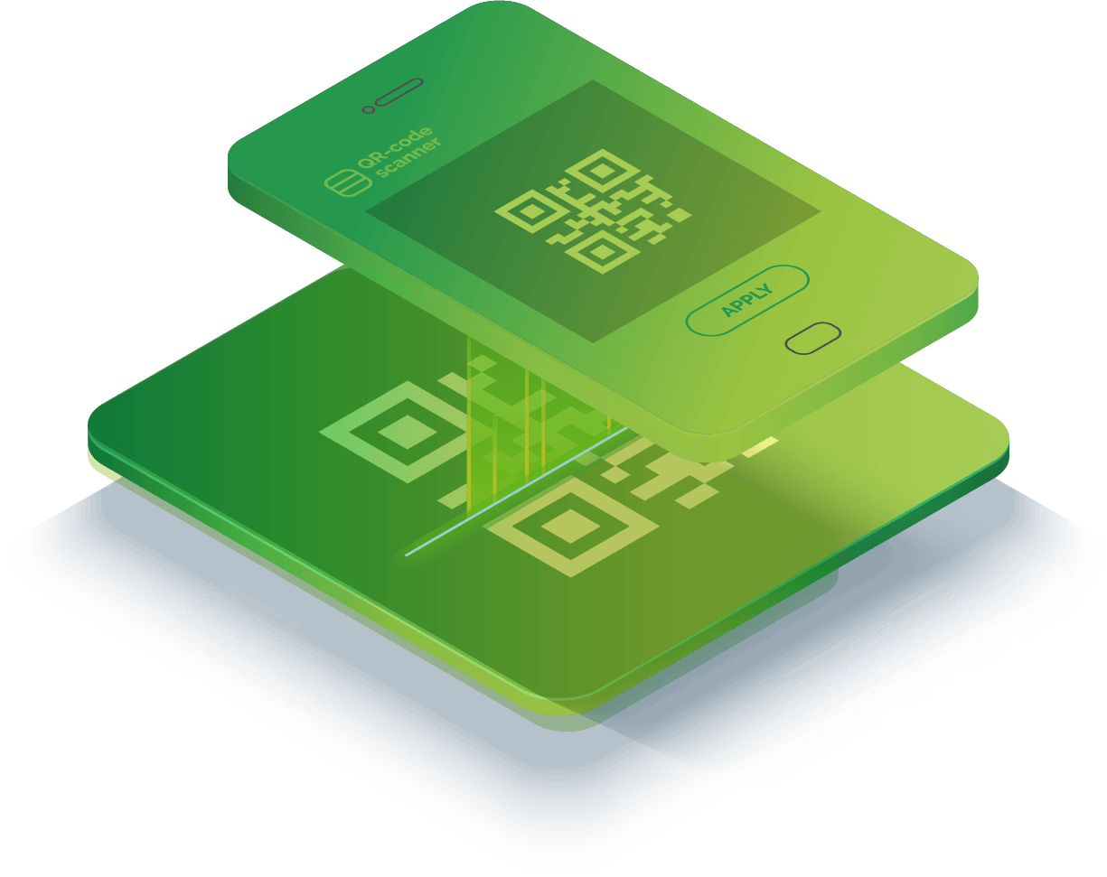
”
OUR AIM IS…
A world without
counterfeit and fraud.
”
WHO WE ARE:
VeriDoc Global is a patent protected Quick Response (QR) Code verification solution using public-key cryptography and Blockchain Technology, providing antifraud / hack proof document verification.
www.veridocglobal.com
VeriDoc Global Solution: Identification and Drivers Licenses

Slide 3
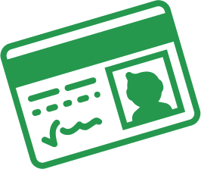
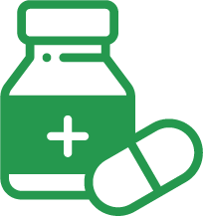
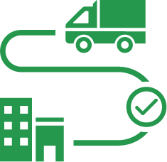
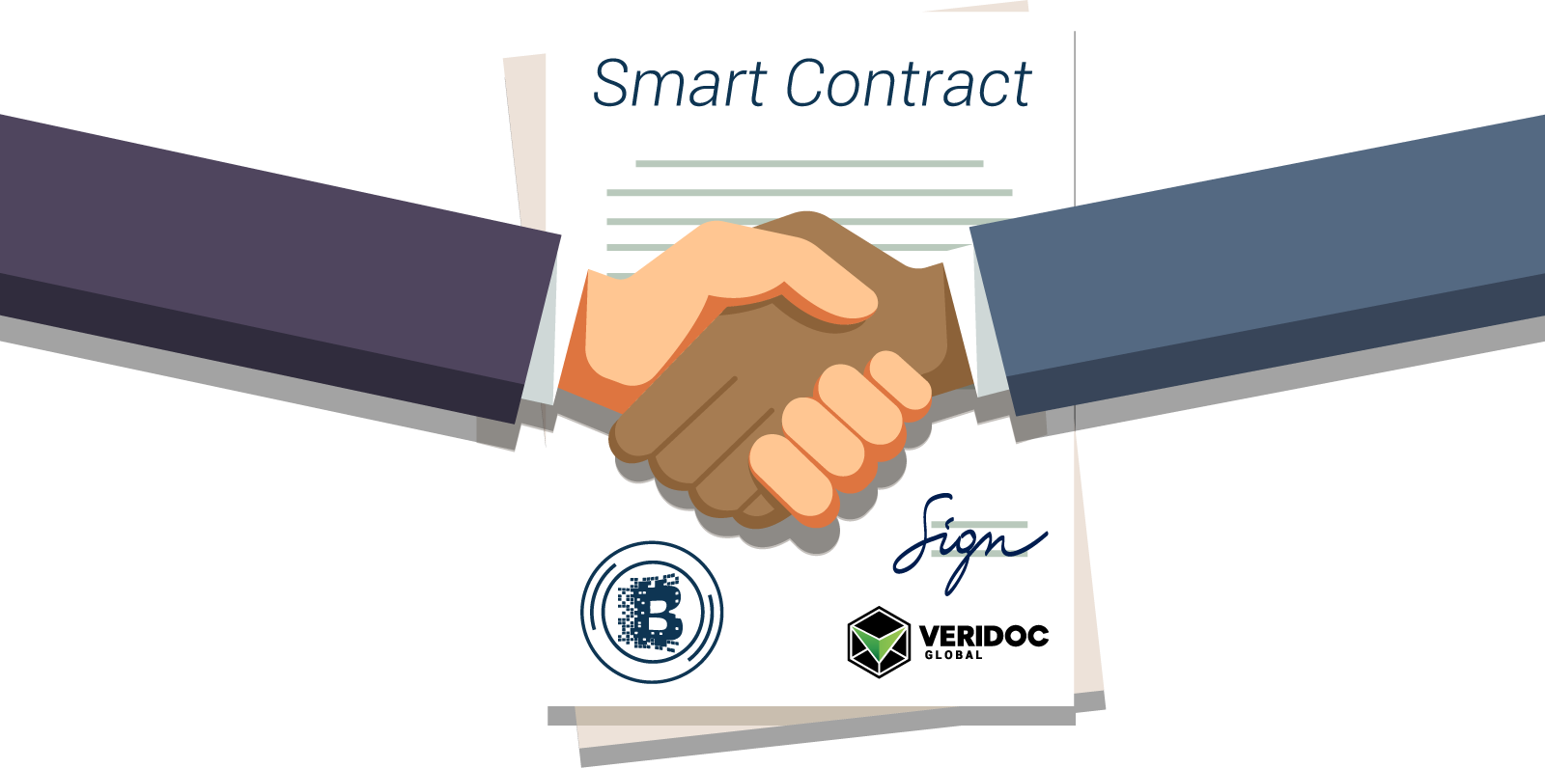
VeriDoc Global solves problems across multiple industries with the implementation of smart contracts.
LEGAL CONTRACTS,
BANK STATEMENTS
LAND TITLES &
MORTGAGE DOCS
IDENTIFICATION &
BIRTH CERTIFICATES
TAX CERTIFICATES & BUSINESS REGISTRATION
PRECIOUS METALS
& LUXURY GOODS
PHARMACEUTICALS
(SERIALIZATION)
SUPPLY CHAINS
FOOD & PRODUCTS
(TRACK & TRACE)
ORIGINAL EQUIPMENT
MANUFACTURER
CERTIFICATES &
TRANSCRIPTS
COLLECTIBLES, TOYS
& ARTWORK
PASSPORTS
www.veridocglobal.com
VeriDoc Global Solution: Identification and Drivers Licenses

Slide 4
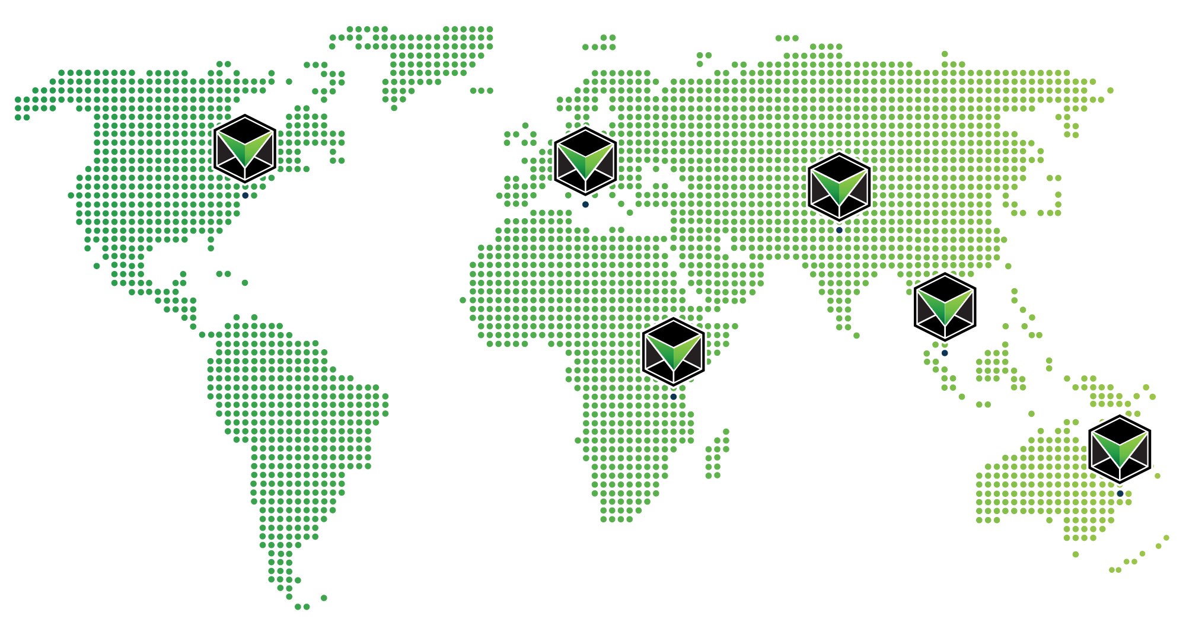
6
WE ARE WORLDWIDE
BRISBANE | NEW YORK CITY | HYDERABAD | SINGAPORE | DAR ES SALAAM | SWATAR
COUNTRIES
120+
TEAM MEMBERS
12
SOLUTIONS
www.veridocglobal.com
VeriDoc Global Solution: Identification and Drivers Licenses

Slide 5
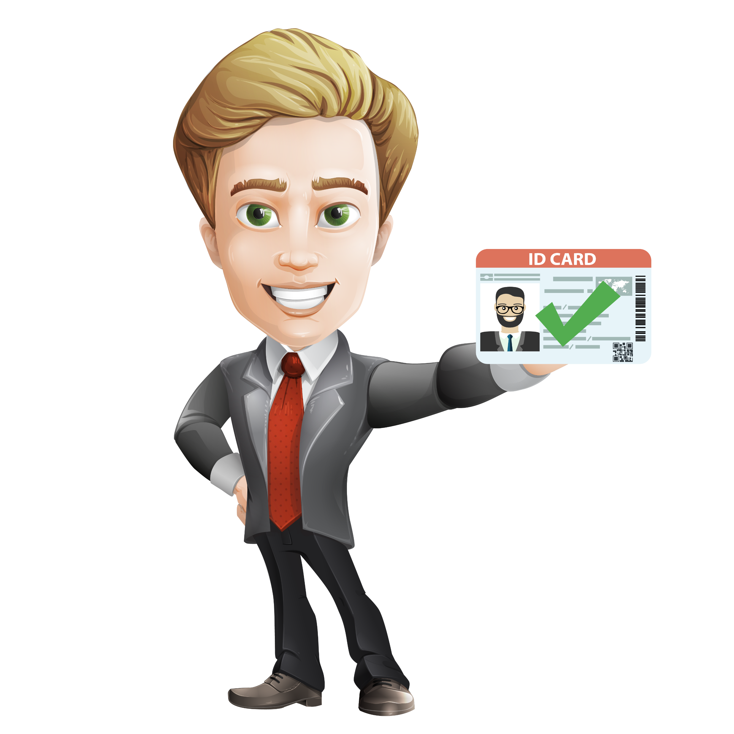
Veridoc Global has developed a verification system
that leverages blockchain technology and smart contracts. Our solution allows you to verify that the ID you are looking at is the true and correct ID.
www.veridocglobal.com
VeriDoc Global Solution: Identification and Drivers Licenses
Notes:
ICON-21.png

Slide 6
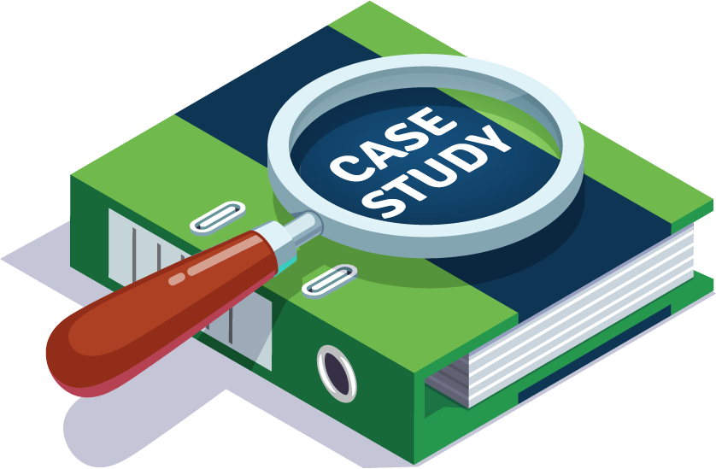
The Problem:
The Solution:
VeriDoc Global has developed a solution that involves embedding a QR code on an ID Card with a unique digital hash inside the QR code.
Fake IDs are usually copies of genuine IDs or illegally modified genuine IDs made by unauthorised persons.
Some IDs, such as driver’s licences, are nationally regarded as credible, high quality identification documents.
The effects of fake IDs continue to trouble governments today.
CASE STUDY.
Fake IDs have been linked to identity theft, bank fraud, social security fraud, illegal purchase of goods and a range of other criminal activities.
The effects of fake IDs continue to trouble governments today. On March 22nd of 2018, a man in the United States used a fake ID to steal a Porsche from a car dealership.
The hash holds a string of information that is then placed on the blockchain network for security, verification and most important end user validation.
www.veridocglobal.com
VeriDoc Global Solution: Identification and Drivers Licenses

Slide 7
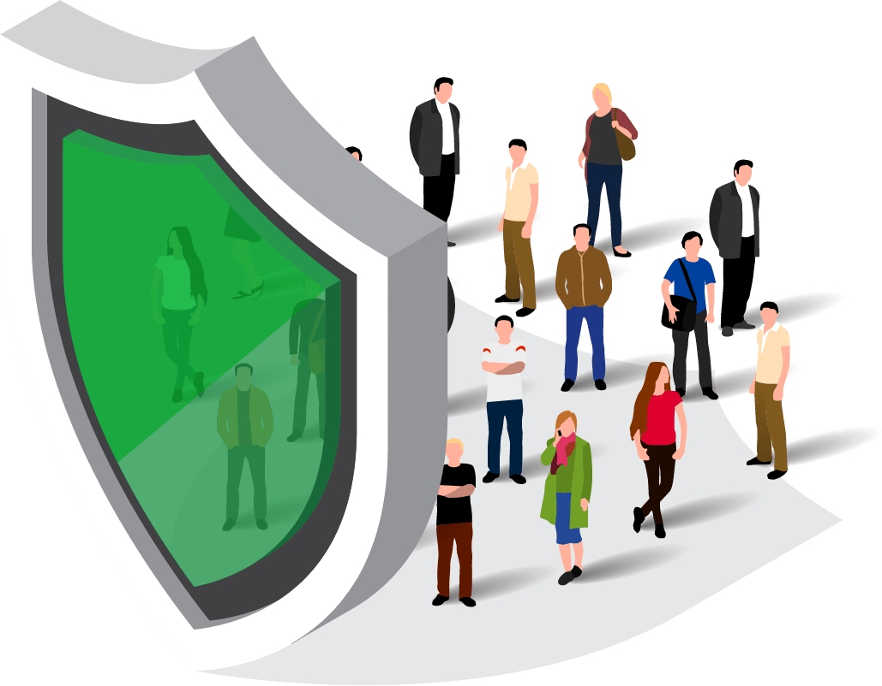
KEY FEATURES
FOREFRONT OF SECURITY
REDUCTION IN COSTS
INCREASED SAFETY
Data is immutable on blockchain and can’t be breached via an attack on a single server or database.
Governments and businesses save time and money lost each year due to document fraud.
Eliminates the ability for criminals and terrorists to create fake IDs.
www.veridocglobal.com
VeriDoc Global Solution: Identification and Drivers Licenses
Notes:
Asset 67@300x-8.png

Slide 8
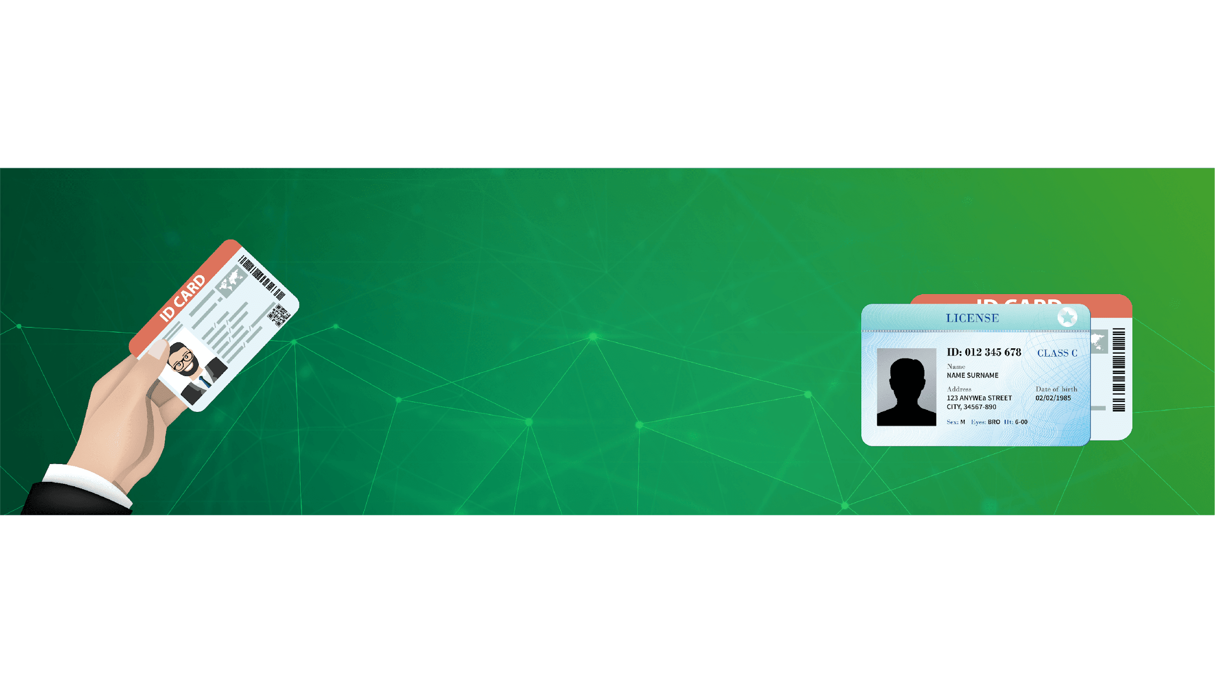
VERIDOC GLOBAL SOLUTION
Some IDs, such as driver’s licences, are nationally regarded as credible, high quality identification documents. Anyone who has undergone the process of applying for a driver’s licence knows that there is a strict application process that requires a range of supporting documentation proving that you are who you say you are.
VeriDoc Global has developed a solution that involves embedding a QR code on an ID with a unique digital hash inside the QR code.
The hash holds a string of information that is then placed on the blockchain network for security, verification and most important end user validation.
Our solution allows you to verify that the Licence you are looking at is the true and correct one.
www.veridocglobal.com
VeriDoc Global Solution: Identification and Drivers Licenses

Slide 9
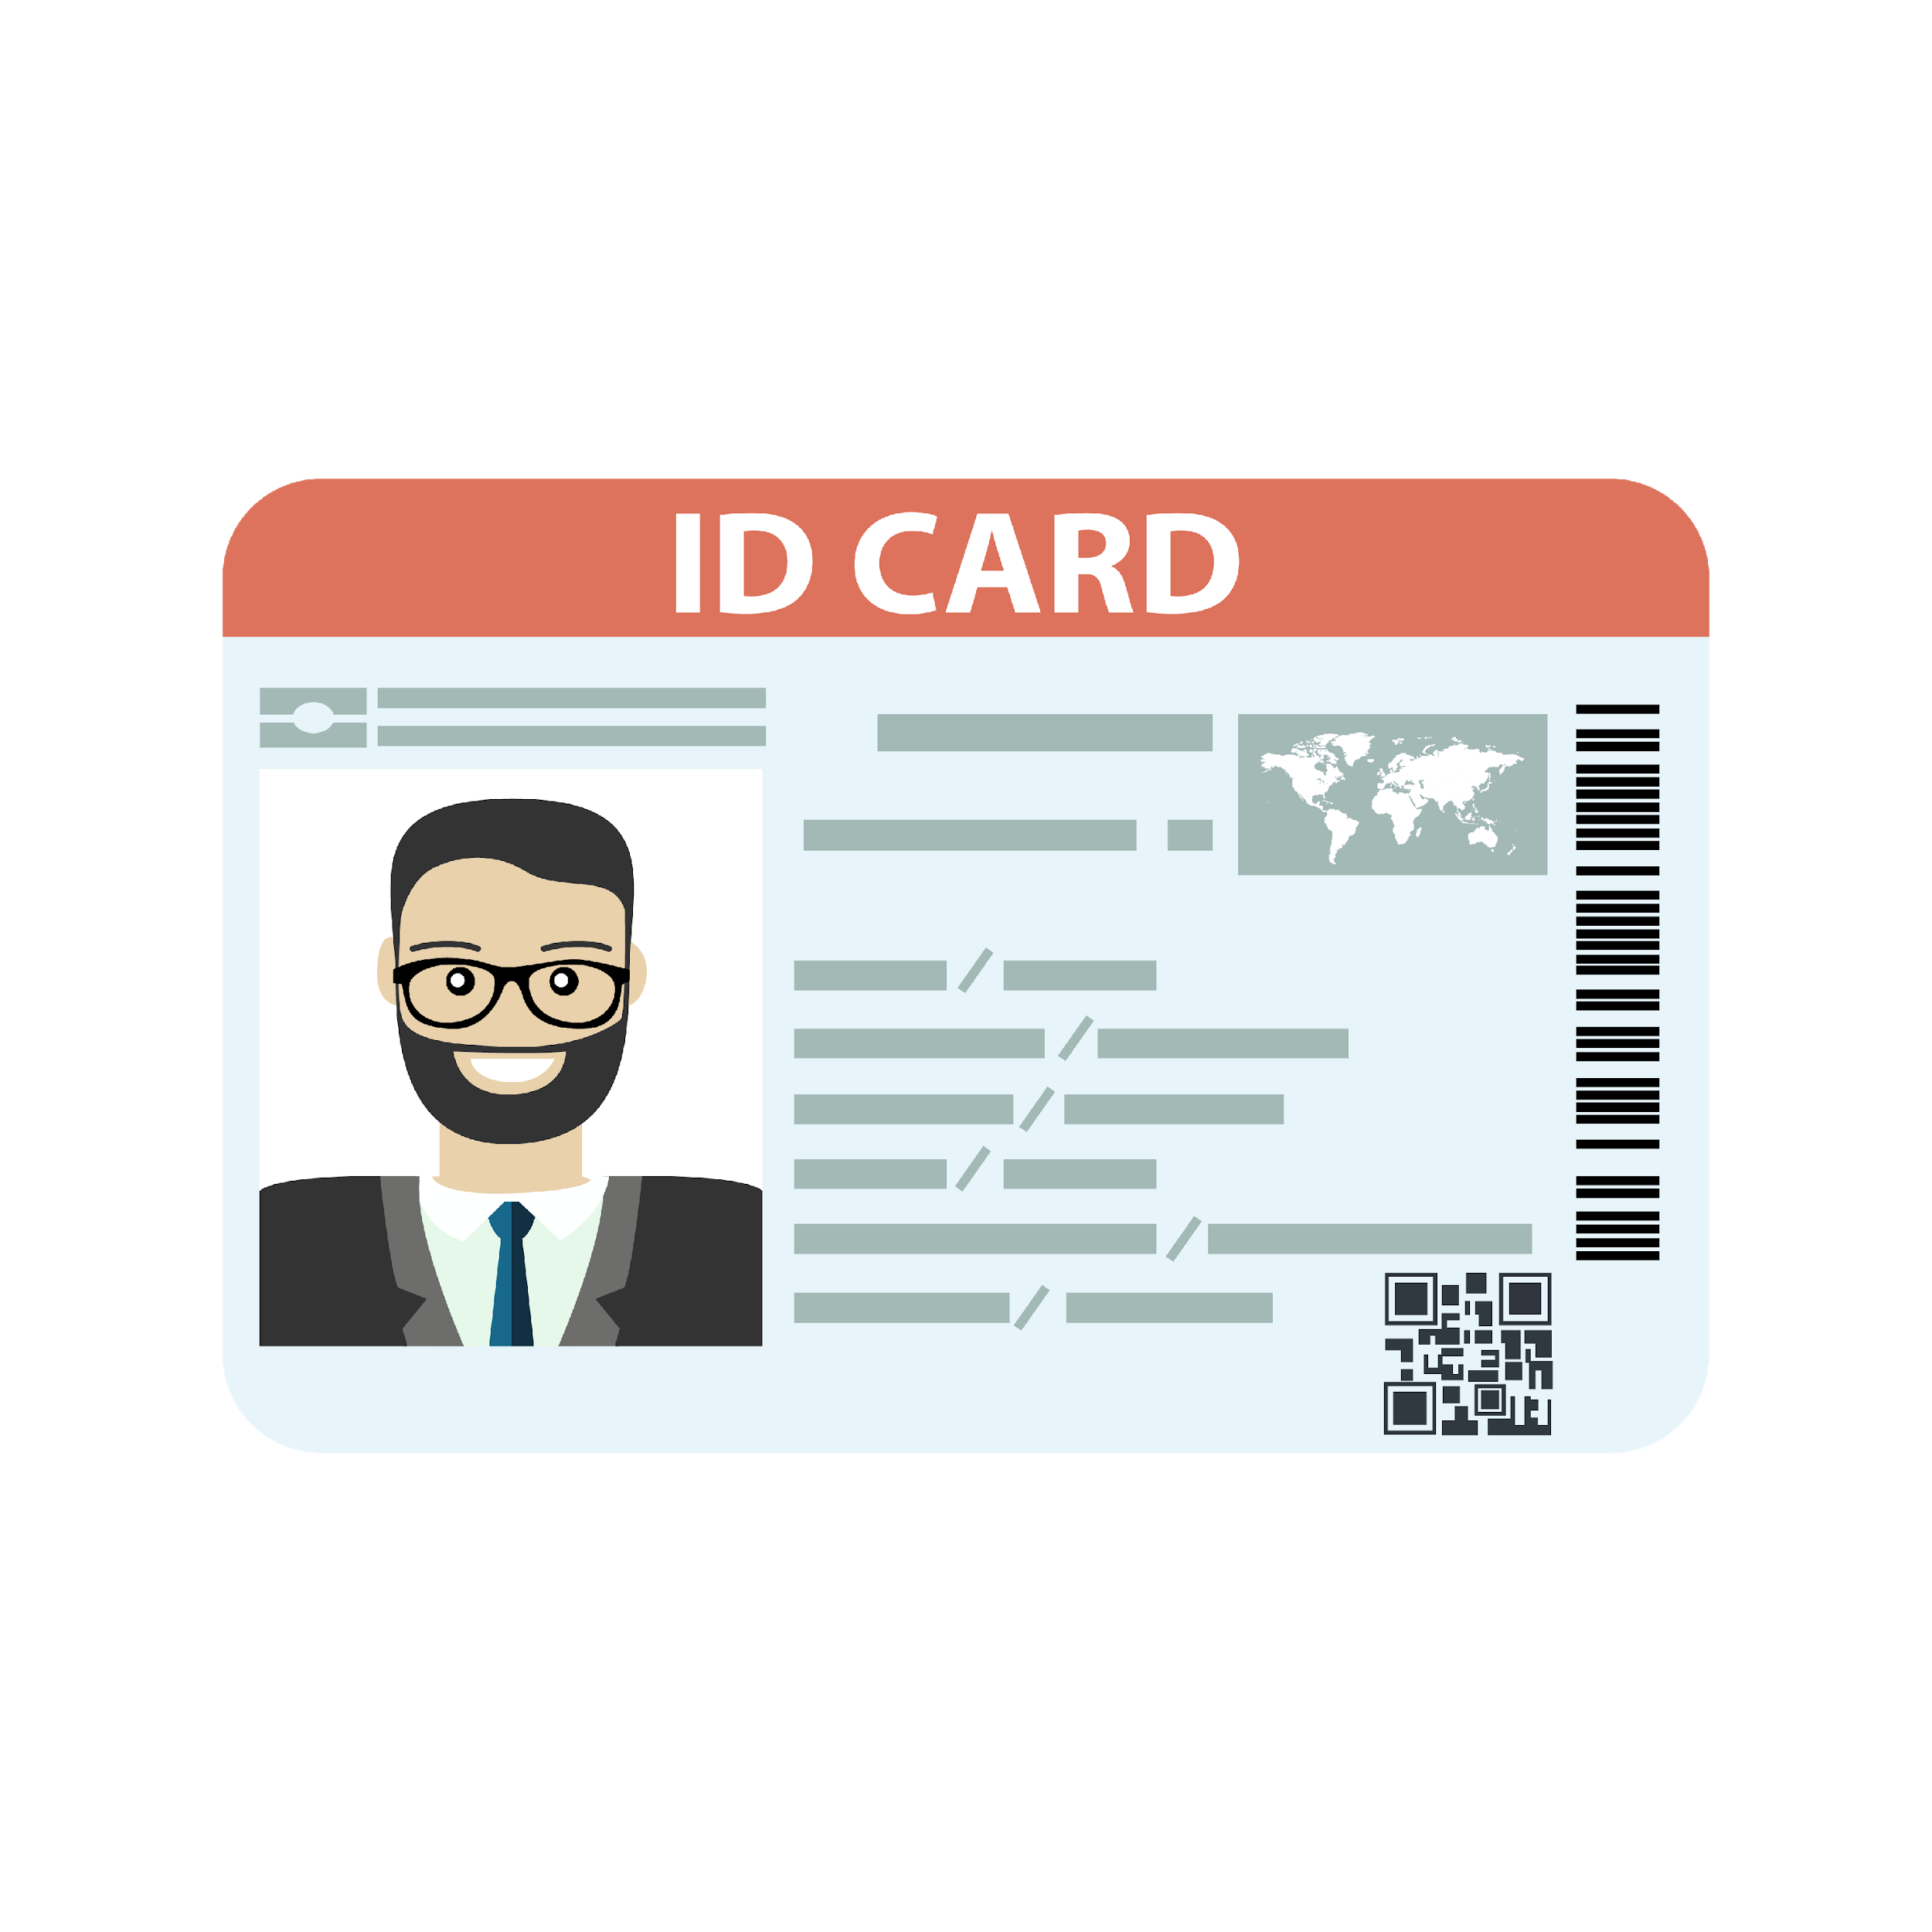
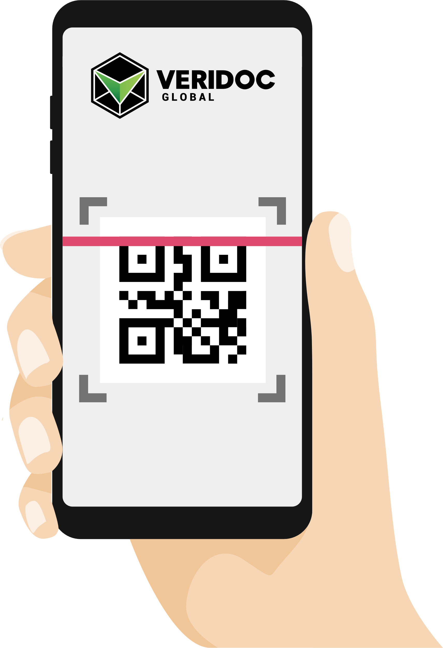
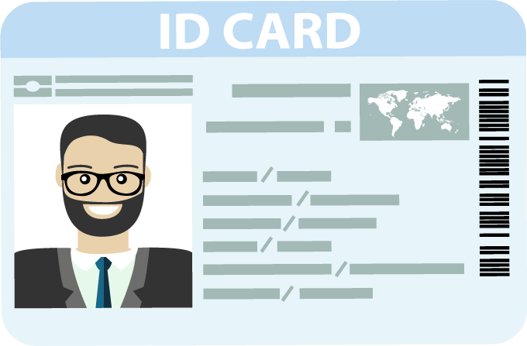
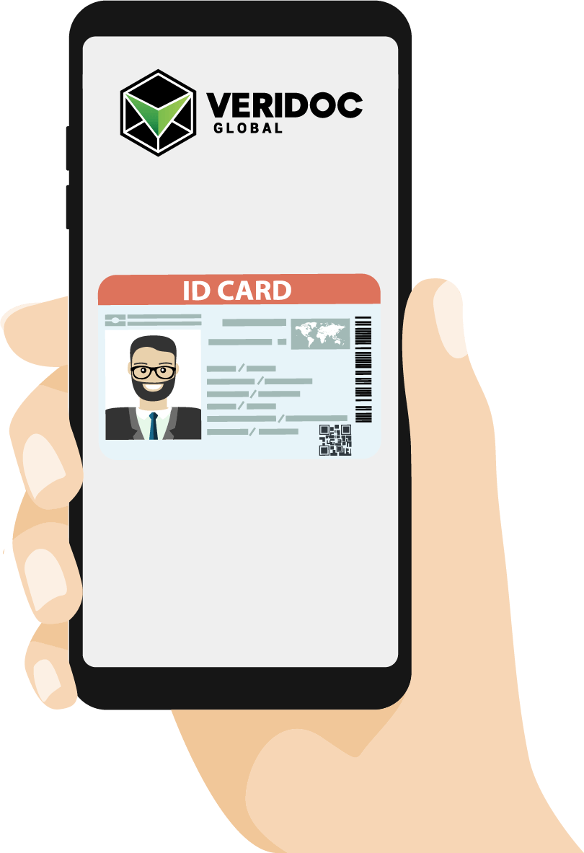
HOW DOES IT WORK?
QR READING APP
ORIGINAL
FAKE
Using any QR reading app, hold your device over the QR code of ID Card and it will scan it.
The app will show you the true and correct ID Card for you to compare and see if the document is an original or a fake.
www.veridocglobal.com
VeriDoc Global Solution: Identification and Drivers Licenses

Slide 10
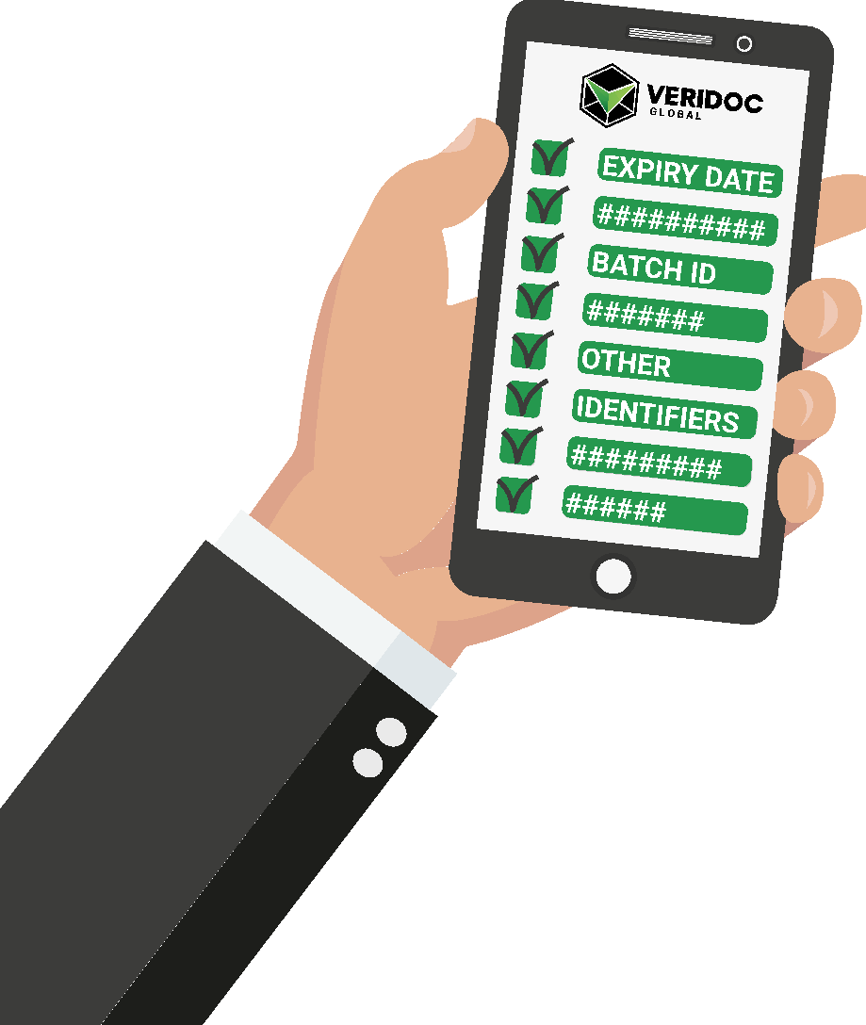
HOW DOES THE HASH VALUE WORK?
The system looks at the hash value inside the QR code.
Then checks the hash value on the blockchain.
The system displays information and identifiers that are linked to the hash value.
www.veridocglobal.com
VeriDoc Global Solution: Identification and Drivers Licenses

Slide 11
How does the QR Code work?
QR codes are a type of matrix barcode or two-dimensional barcode.
A standard QR code can hold up to 3Kb of data, compared to a standard barcode which holds less than 100 characters.
VeriDoc Global uses a unique digital hash value that is stored on the QR code. When a QR code reader is used to scan the QR code, the system looks at the unique hash value and then checks that value on the blockchain. The system verifies that the hash value exists on the blockchain and then displays the information that is linked to the hash value.
This significantly improves supply chain management because blockchain technology prevents the data and the QR code from ever being changed or removed.
www.veridocglobal.com
VeriDoc Global Solution: Identification and Drivers Licenses

Slide 12
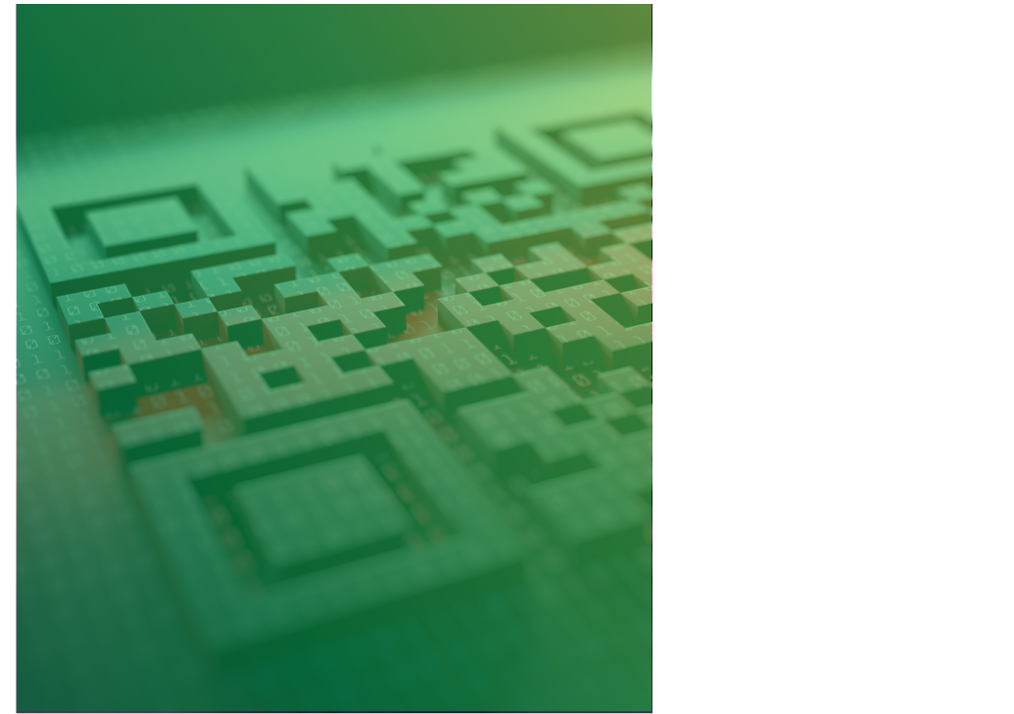
THE VERIDOC GLOBAL PROTOCOL DETERS COUNTERFEITERS FROM COPYING A QR CODE AND ALSO PREVENTS THEM FROM USING THEIR OWN QR CODES.
What if someone copies the QR code?
Success factors:
Each document has a unique hash value and can’t be verified in two places at once. If the data collected reports this occurrence, the QR code for the banknote can be blocked or put into quarantine.
The VeriDoc Global QR code reader allows the RBA to have 100% control over the QR codes that are verifiable. Counterfeiters who try to replicate the process with their own QR codes will not be able to get past the security checks that take place using the VeriDoc Global app.
www.veridocglobal.com
VeriDoc Global Solution: Identification and Drivers Licenses

Slide 13
What About
RFID Chips ?
There is no doubt that RFID technology has many benefits, however RFID also has its vulnerabilities.
Some of the reasons why RFID technology is so vulnerable are:
RFID chips use “contactless technology” which means that data is transferred over the airwaves. There is plenty of evidence that shows that RFID tags can and have been hacked.
RFID tags can be read without your knowledge. Unlike magnetic strips and QR codes which need to be swiped or scanned, anyone with an RFID tag reader can read your RFID tag without you knowing.
RFID tags can be read from greater distances. Most RFID systems are designed so that the distance between the tag and the reader are kept to a minimum, however a high gain antenna can be used to read tags from greater distances, which leads to privacy issues
www.veridocglobal.com
VeriDoc Global Solution: Identification and Drivers Licenses

Slide 14
Document Producer and Verification Flow
www.veridocglobal.com
VeriDoc Global Solution: Identification and Drivers Licenses

Slide 15
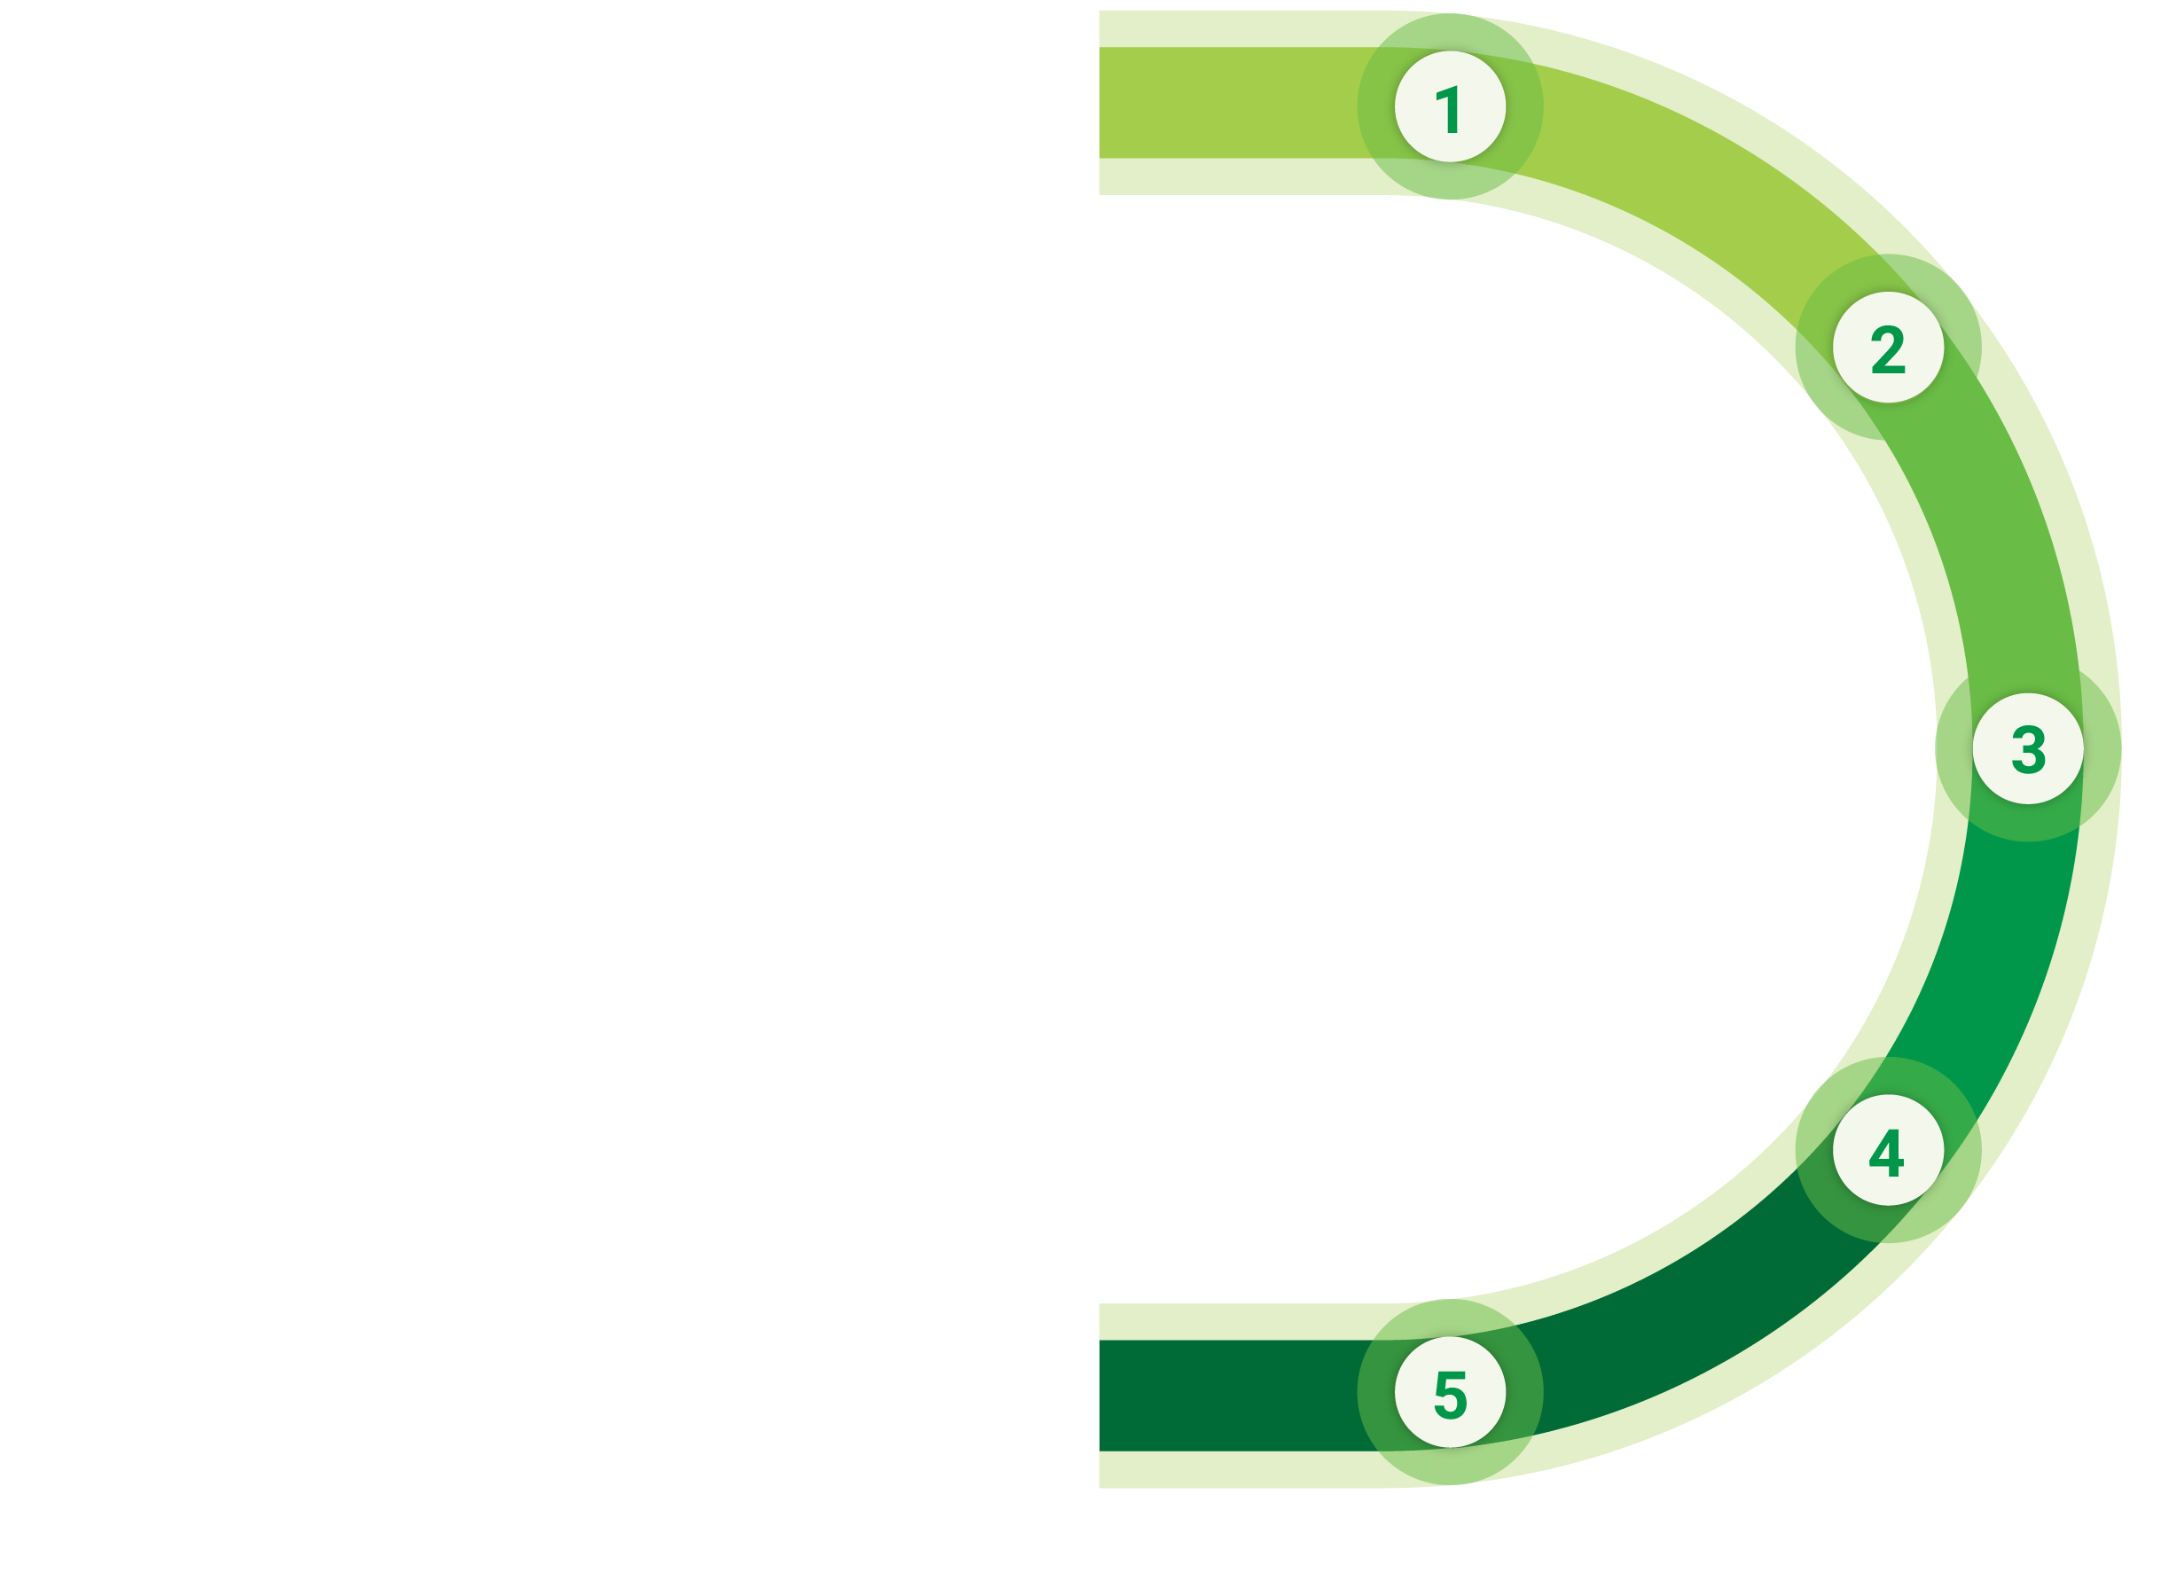
CREATE AN ID CARD
Government creates an ID card.
GENERATE QR CODE
VeriDoc Global generates a unique QR code and places the QR code inside of the ID card.
GENERATE PDF IN
CLIENT’S SECURED SERVER
VeriDoc Global generates a PDF from the new document and stores this on the client’s secured server.
ID CARDS
CREATOR FLOW
GENERATE UNIQUE
HASH VALUE ON BLOCKCHAIN
VeriDoc Global generates a unique hash value for the ID and places this on the blockchain.
POPULATE THE DATABASE
VeriDoc Global populates a database with the unique hash value, blockchain transaction record and URL of the PDF (to preview the original ID card).
www.veridocglobal.com
VeriDoc Global Solution: Identification and Drivers Licenses

Slide 16
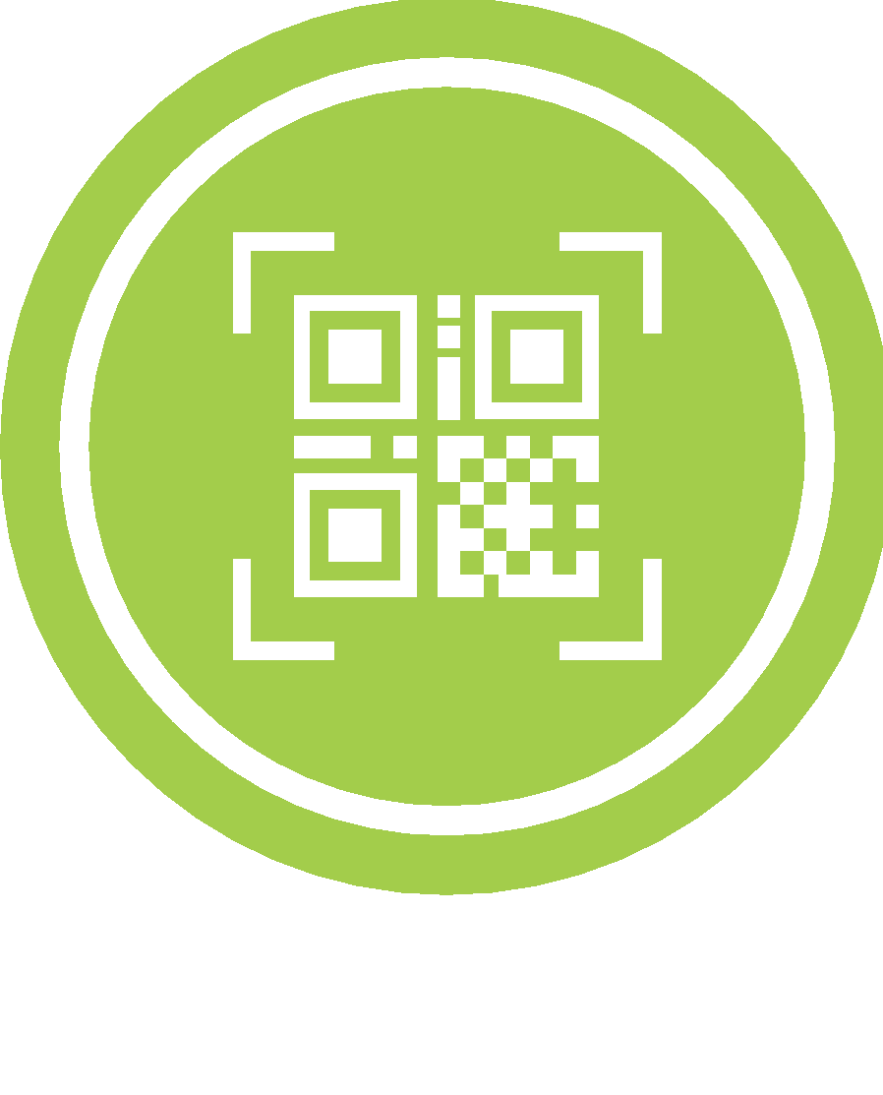
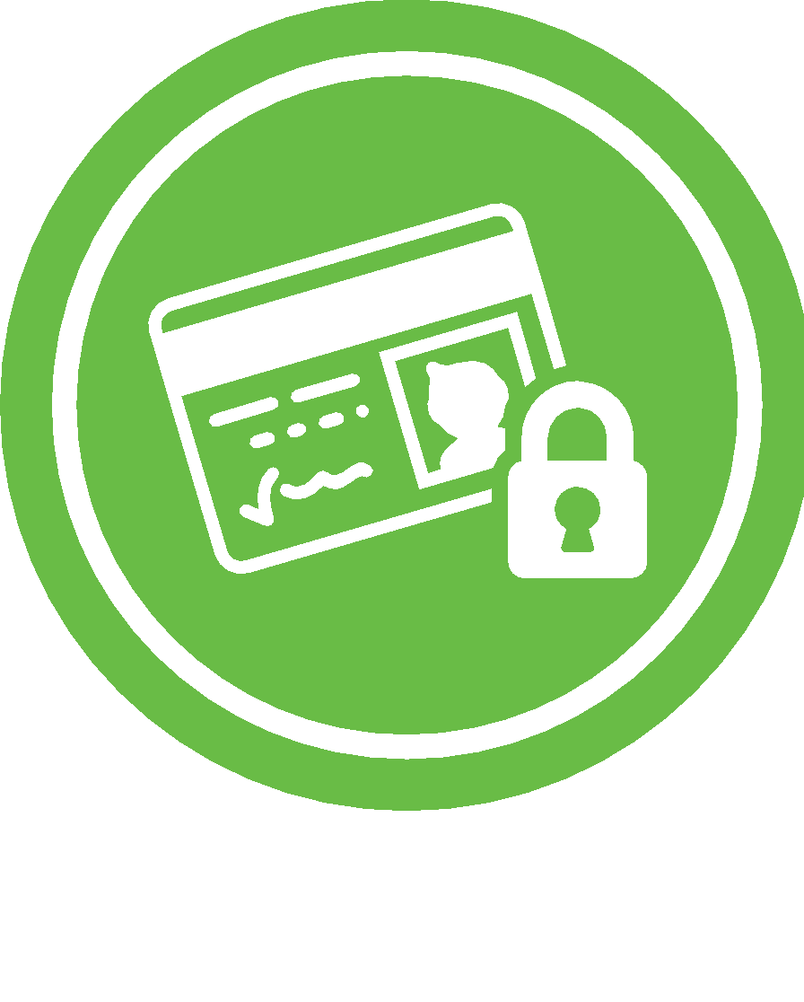
QR CODE READER
ID card is scanned
using a QR code reader.
PREVIEW ORIGINAL ID CARD
User is redirected to a secure VeriDoc Global webpage that displays the unique hash value, blockchain transaction record and preview of the original ID card.
ID CARDS
READER FLOW
VISUAL INSPECTION
User validates the authenticity of the ID card by visual inspection.
VALIDATE HASH VALUE ON BLOCKCHAIN
User may validate the unique hash value on the blockchain and verify that the hash values are identical.
INFORMATION UPDATE
The QR code can be updated with additional information showing that a person has less points available on their driver’s licence due to speeding offences (optional).
www.veridocglobal.com
VeriDoc Global Solution: Identification and Drivers Licenses

Slide 17
THE FUTURE OF Identification and License Security
www.veridocglobal.com
VeriDoc Global QR Code Reader App Available Now

